Slide 1
Workshop (hidden slide)
Workshop Duration:
approx. 4hrs
Customer Attendees:
ITDM & BDM: Enterprise Architect, Business IT leads, Governance teams, IT Director, Cloud Lead, Operations Lead, Finance. Cloud team if formed
Objectives

Slide 2
Best practices for planning and running workshops
1. Be clear on goals and outcomes
2. Decide who will attend
3. Choose the right location
4. Be clear on the agenda
5. Share the follow-up plan
Getting people involved:
Keep group sizes small to encourage participation
Have a mix of different people in the various groups
Be clear on how to capture ideas (shout out or write down)
Get groups to evaluate ideas to narrow down ideas
Overall tips:
Have a facilitator who manages time and process
Start the meeting with some icebreakers
Structure the workshop so that the busiest attendees can attend the most critical parts
As some of the topics may be sensitive related to roles and org structure, try to share examples of where you have seen success in the past.
Source: www.mindtools.com

Slide 3
Basic structure of the workshop
Review / Overview of Cloud Adoption Framework and Governance
Assessment of current environment using Governance Benchmark
Workshop 1: identify risks and compliance requirements
Based on assessment outcome choose governance discipline(s) to build and evolve the governance baseline
Each discipline baseline will have sections to guide the workshop
Slides to tee up the discipline, give background and context.
A brief intro into Azure tooling to support baseline implementation
The actual workshop will be based off the slide which lists example questions focusing on policies which the customer should consider
NOTE: the questions in each section are examples and intended to drive a conversation.

Slide 4
Workshop Planning
Workshop Planning Special environment creation Azure portal access Root access for MG's Lunch/Food Allergies/Attire/Dates/Location | Workshop Success Factors The goal is to identify workloads and train the customer Invite X with the goal of Y attending (based on room size and location) Lead time is X weeks Schedule opportunity follow ups during the workshop keep the momentum going Invite continuous communication, both email and in person Invite a mix of persons from different business units and roles

Slide 5

Cloud Adoption Framework for Azure | Governance Workshop
Speaker
Title
Notes:
Welcome slide

Slide 6
Microsoft Cloud Adoption Framework
Overview
The Microsoft Cloud Adoption Framework for Azure is a collection of documentation, technical guidance, best practices and tools that aligns strategies for business, organizational readiness, and technology to enable desired business outcomes faster and adopt the cloud with confidence

Slide 7
Microsoft Cloud Adoption Framework for Azure
Best practices
Templates
People
Process
Technology
Documentation
Tools
Achieve balance
Align business, people and technology strategy to achieve business goals with actionable, efficient, and comprehensive guidance to deliver fast results with control and stability.

Slide 8
Microsoft Cloud Adoption Framework for Azure
Adopt
Define strategy
Understand motivations
Business outcomes
Business justification
Prioritize project
Plan
Digital estate
Initial organization alignment
Skills readiness plan
Cloud adoption plan
Ready
Azure setup guide
First landing zone
Expand the landing zone
Best practice Validation
Migrate
• Migration Guide
• First workload migration
• Expanded scenarios
• Best practice validation
• Process improvements
Innovate
• Innovation guide
• Expanded scenarios
• Best practice validation
• Process improvements
Govern
Methodology • Benchmark
initial best practice • Governance maturity
Manage
Business commitments
operations baseline • Ops maturity

Slide 9
Microsoft Cloud Adoption Framework
Governance

Slide 10
Objective of this Model: Create Balance
Control & Stability
Speed &
Results
Notes:
REF: https://docs.microsoft.com/en-us/azure/cloud-adoption-framework/getting-started/enable

Slide 11
Get started with cloud governance
1
2
Methodology overview
Governance benchmark
Establish a basic understanding of cloud governance
Assess your current state and the future state to get started
3
4
Initial Governance Foundation
Evolve Governance Foundation
Begin establishing your governance foundation by implementing a set of governance tools
Iteratively add governance controls to address risks
Notes:
REF: https://docs.microsoft.com/en-us/azure/cloud-adoption-framework/govern/guides/

Slide 12
Governance methodology overview

Slide 13
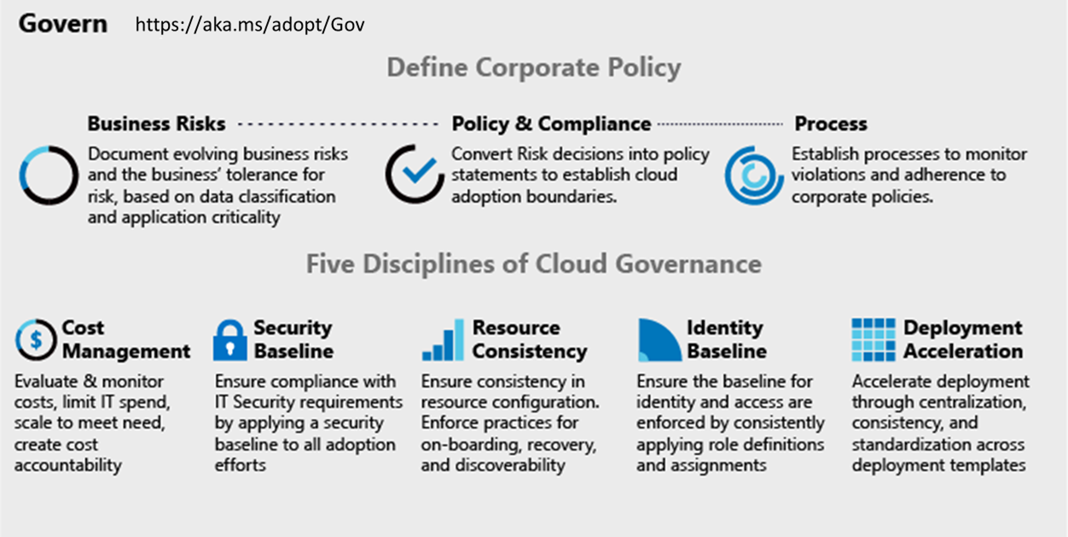
Cloud Adoption Framework | Governance Model
Governance End State that fosters trust and builds confidence
Corporate Policy
Governance is a big, intimidating topic. Establish proper scope by mitigating tangible risks through corporate policy.
Cloud Governance Disciplines
Governance is a team sport. Empower multiple team members by decomposing corporate policy changes into five actionable disciplines.
Cloud Governance Team
A team of governance minded cloud architects can evolve these disciplines, ensure governance consistency, and accelerate deployment.
Notes:
REF: https://docs.microsoft.com/en-us/azure/cloud-adoption-framework/govern/governance-disciplines

Slide 14

Making Governance Actionable with Native Tools
Azure Monitor
Azure Blueprints
Azure Policy
Azure Cost Management
Azure Advisor
Azure Portal
Azure EA Content Pack
Azure Blueprint
Azure Policy
Resource Grouping & Tagging
Resource Manager Templates
Azure Advisor
Azure DevOps
Azure Site Recovery
Azure Backup
Azure Automation
Azure Blueprints
Azure Policy
Azure Security Center
Azure Sentinel
Subscription Design
Encryption
Hybrid Identity
Azure Networking
Azure Automation
Azure Blueprints
Azure Policy
Azure Monitor
Azure Advisor
Resource Manager Templates
Resource Graph
Management Groups
Azure Blueprints
RBAC
Azure AD
Azure AD B2B
Azure AD B2C
Directory Federation
Directory Replication
Notes:
Cost Management – REF: https://docs.microsoft.com/en-us/azure/cloud-adoption-framework/govern/cost-management/
Security Baseline – REF: https://docs.microsoft.com/en-us/azure/cloud-adoption-framework/govern/security-baseline/
Resource Consistency – REF: https://docs.microsoft.com/en-us/azure/cloud-adoption-framework/govern/resource-consistency/
Identity Baseline – REF: https://docs.microsoft.com/en-us/azure/cloud-adoption-framework/govern/identity-baseline/
Deployment Acceleration – REF: https://docs.microsoft.com/en-us/azure/cloud-adoption-framework/govern/deployment-acceleration/

Slide 15
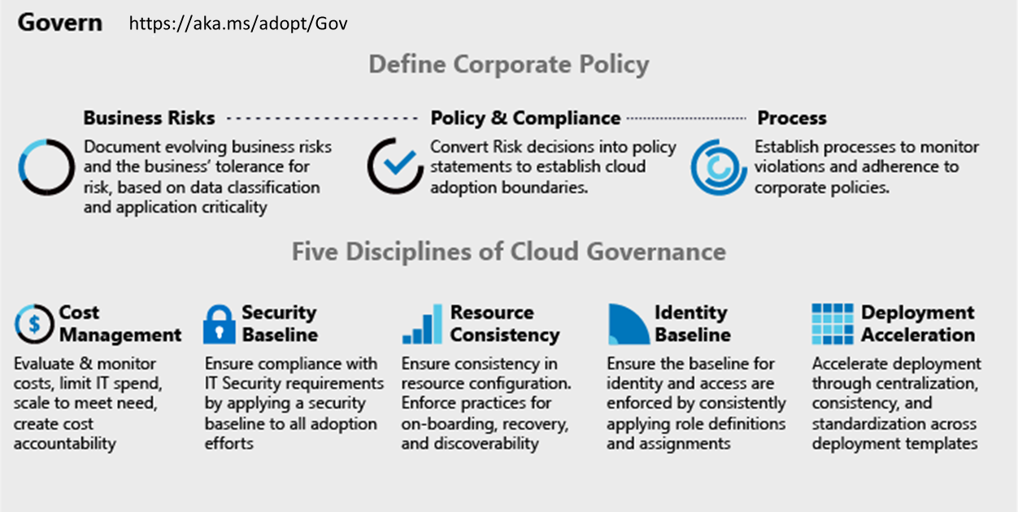
Integrating 3rd Party Tools
Monitoring 3rd parties
OpsCompass
Splunk
AppDynamics
Solarwinds
New Relic
Data Dog
Cost Management 3rd parties
HashiCorp Terraform (ROI tools)
Cloudcheckr
Deployment 3rd parties
Nagios
HashiCorp Terraform
devops tools like Chef, Puppet, Ansible, Zabix
Security baseline 3rd parties
Splunk
HashiCorp Vault
F5
Gemalto
Palo Alto
CheckPoint
Dome9
Discovery, onboarding, and recovery 3rd parties
ServiceNow
HashiCorp Terraform
3rd party identity providers
HashiCorp Vault
RSA
Omada
Ping Identity
SailPoint
Notes:
What third parties can be used to accomplish similar goals? Reference third party sites/capabilities
Cost Management – REF: https://docs.microsoft.com/en-us/azure/cloud-adoption-framework/govern/cost-management/
Security Baseline – REF: https://docs.microsoft.com/en-us/azure/cloud-adoption-framework/govern/security-baseline/
Resource Consistency – REF: https://docs.microsoft.com/en-us/azure/cloud-adoption-framework/govern/resource-consistency/
Identity Baseline – REF: https://docs.microsoft.com/en-us/azure/cloud-adoption-framework/govern/identity-baseline/
Deployment Acceleration – REF: https://docs.microsoft.com/en-us/azure/cloud-adoption-framework/govern/deployment-acceleration/

Slide 16
Benchmark your governance state

Slide 17
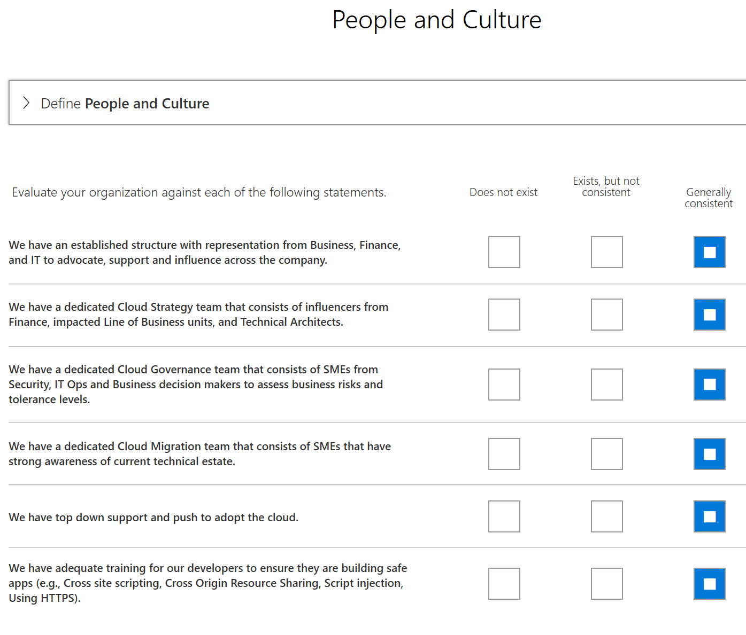
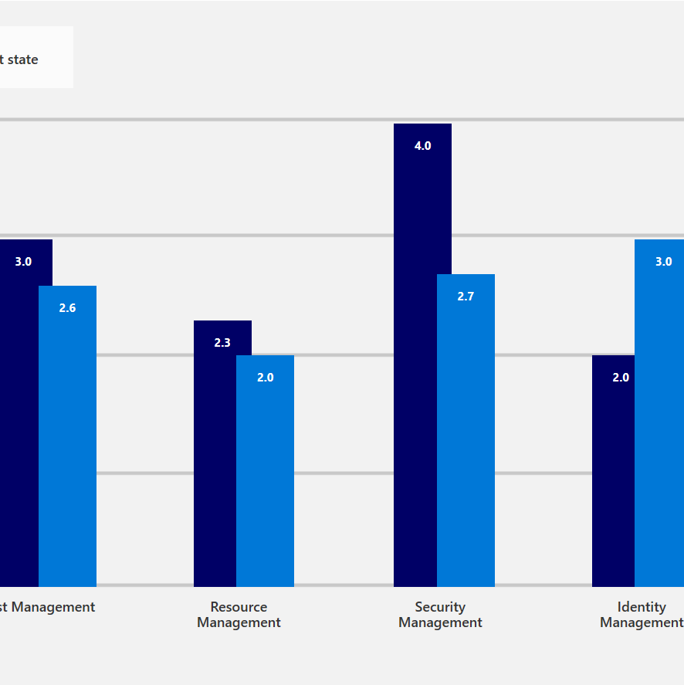
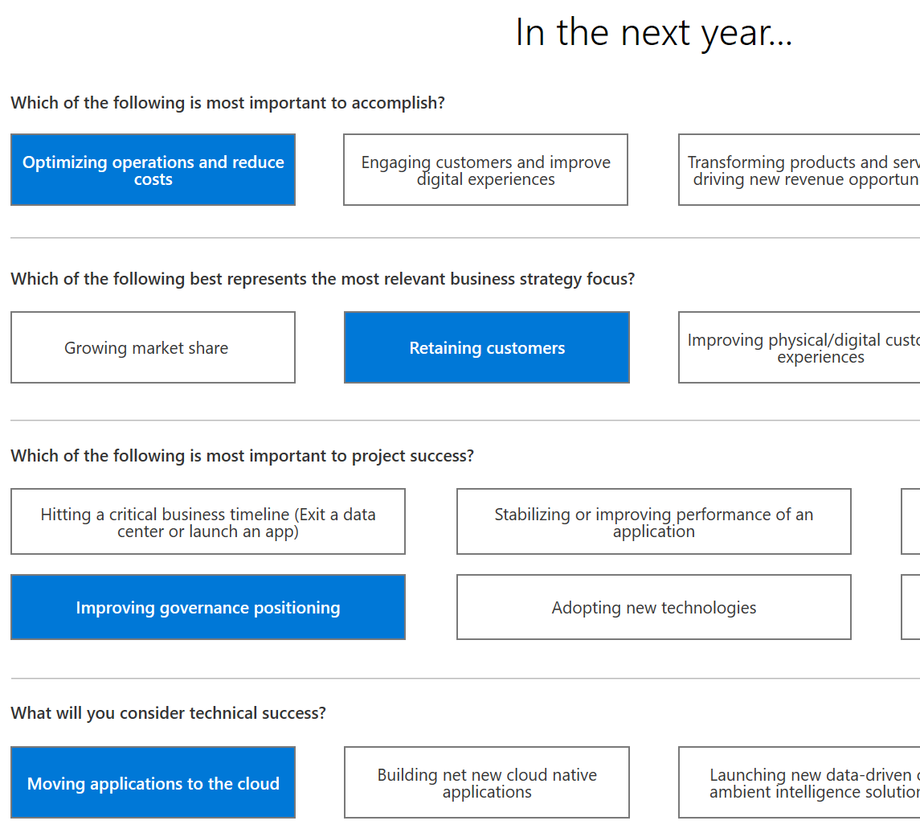
Before we begin…..
Let’s take a few minutes to capture current state of your governance using the “Governance Benchmark Tool”
http://aka.ms/adopt/gov/assess
Notes:
In this section, using the Governance Benchmark tool helps drive critical thinking across attendees/participants
REF: http://aka.ms/adopt/gov/assess

Slide 18
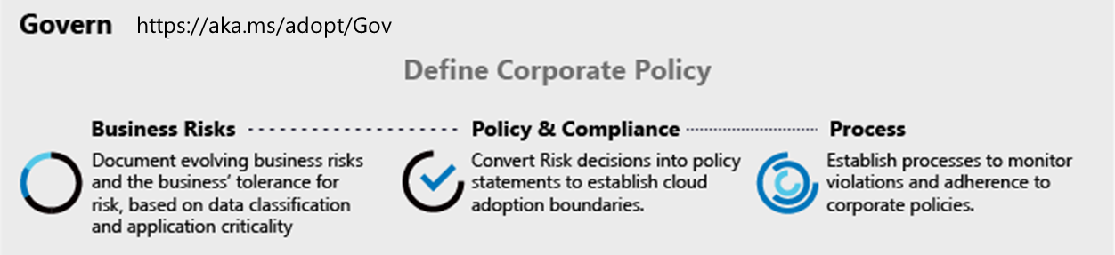
Workshop segment #1 Engage stakeholders to understand business risks
Example:
What are your compliance requirements?
Have you identified your business risks as it relates to cloud?
What are your business priorities and reasons for moving to cloud?
How do you think about data risks and data governance?
Is there a list of applications which are prioritized by business impact?
Do you have specific application governance requirements?
How do you audit for compliance ?

Slide 19
Workshop Lab A - Govern Governance Assessment
Read the Customer situation (slides are in the section called Customer situation)
Fill out the Cloud Adoption Framework Governance Benchmark Tool based on the information on the Customer situation. Note: Some of the information will be incomplete so feel free to take some liberties with the benchmark tool.
Notes:
This questionnaire is designed to help you identify gaps in your organization across six key domains as defined in the Microsoft Cloud Adoption Framework. It provides a personalized report that outlines the difference between your current state and business priorities, and tailored resources to help you get started.
Survey the audience about how the engagement went:
How did the assessment go for each individual?
What information did the assessment provide that they didn’t already know or how did they change their perspective
What kinds of decisions did these assessments help with?
Immediate (within a month)
Near-term (within a quarter)
Long term (fiscal year and beyond)
How did the assessment provide value for developing plans?
What role would these assessments (or other potential future assessments) play in developing plans?
In which situations could the assessment provide the most value?

Slide 20
Defining Initial Governance for your organization

Slide 21
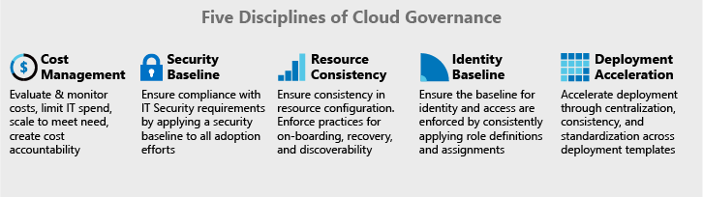
Building the Governance MVP for your organization
Governance MVP
Start small. Establish a foundation that can quickly evolve as cloud adoption and cloud governance mature. Mitigate tangible risks identified in the cloud adoption plans.
Risk Evolutions
As additional iterations of cloud adoption are planned, the risk profile will change. The Cloud Governance Team monitors those adoption plans to identify risks and evolve corporate policy statements.
Caution: take a balanced approach to implementation, audit then apply
Notes:
We have done an assessment lets focus on a few areas that we can address within the time frame allocated. Note we are building an MVP with you to get something established, once this is done we can continue to evolve to further improve.
REF: https://docs.microsoft.com/en-us/azure/cloud-adoption-framework/govern/methodology

Slide 22
Build the Resource Consistency

Slide 23
Workshop | Creating the resource mgmt. baseline
Estimated time frame: approx. ~ 2hrs
Participants: Cloud Architects
Outcomes:
Management groups, Subscriptions, Tags
Requirements:
Understanding of internal org structures, compliance requirements
Triggers:
Getting started with Azure and need help in cloud environment setup
Interested in learning about best practices in resource management in Azure
Notes:
A basic slide to outine each mini-workshop…

Slide 24
Factors that influence the right setup
Organize Azure to reflect your organization, not the other way!
Cost transparency:
Set up a cost structure that reflects the actual usage for departments and projects.
Tagging and ownership
Allowed resource types (policy)
Roles and responsibility:
Who has access to what. Account owners and delegations (RBAC)
Minimal access level to carry out the task.
Design for Partners and 3rd parties
Compliance and Security:
Allowed locations e.g. EU (policy)
Network and connectivity (Internet facing, or using the approved VNETS? Policy and NSG)
Continuous Monitoring and integration to existing ITSM (Azure Monitor)
Notes:
Standard Enterprise Governance Guide: https://docs.microsoft.com/en-us/azure/cloud-adoption-framework/govern/guides/standard/
Complex Enterprise Governance Guide: https://docs.microsoft.com/en-us/azure/cloud-adoption-framework/govern/guides/complex/

Slide 25
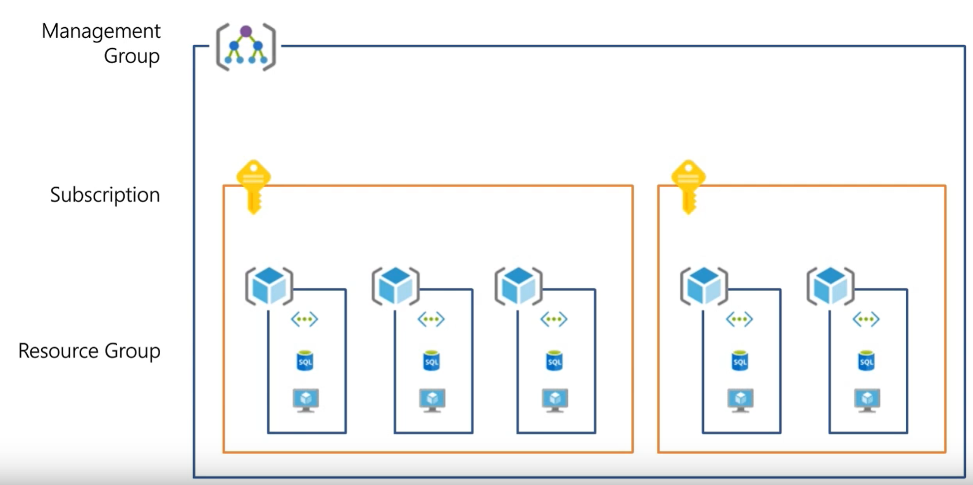
What is Resource Consistency?
The basic foundation of all governance practices. Achieving the right Governance starts with the correct resource organization.
Management Groups: To reflect security, operations and business/accounting hierarchies
Subscriptions: To group similar resources into logical collections
Resource Groups: To further group applications or workloads into deployment and operations units
Notes:
Standard Enterprise Governance Guide: https://docs.microsoft.com/en-us/azure/cloud-adoption-framework/govern/guides/standard/
Complex Enterprise Governance Guide: https://docs.microsoft.com/en-us/azure/cloud-adoption-framework/govern/guides/complex/

Slide 26
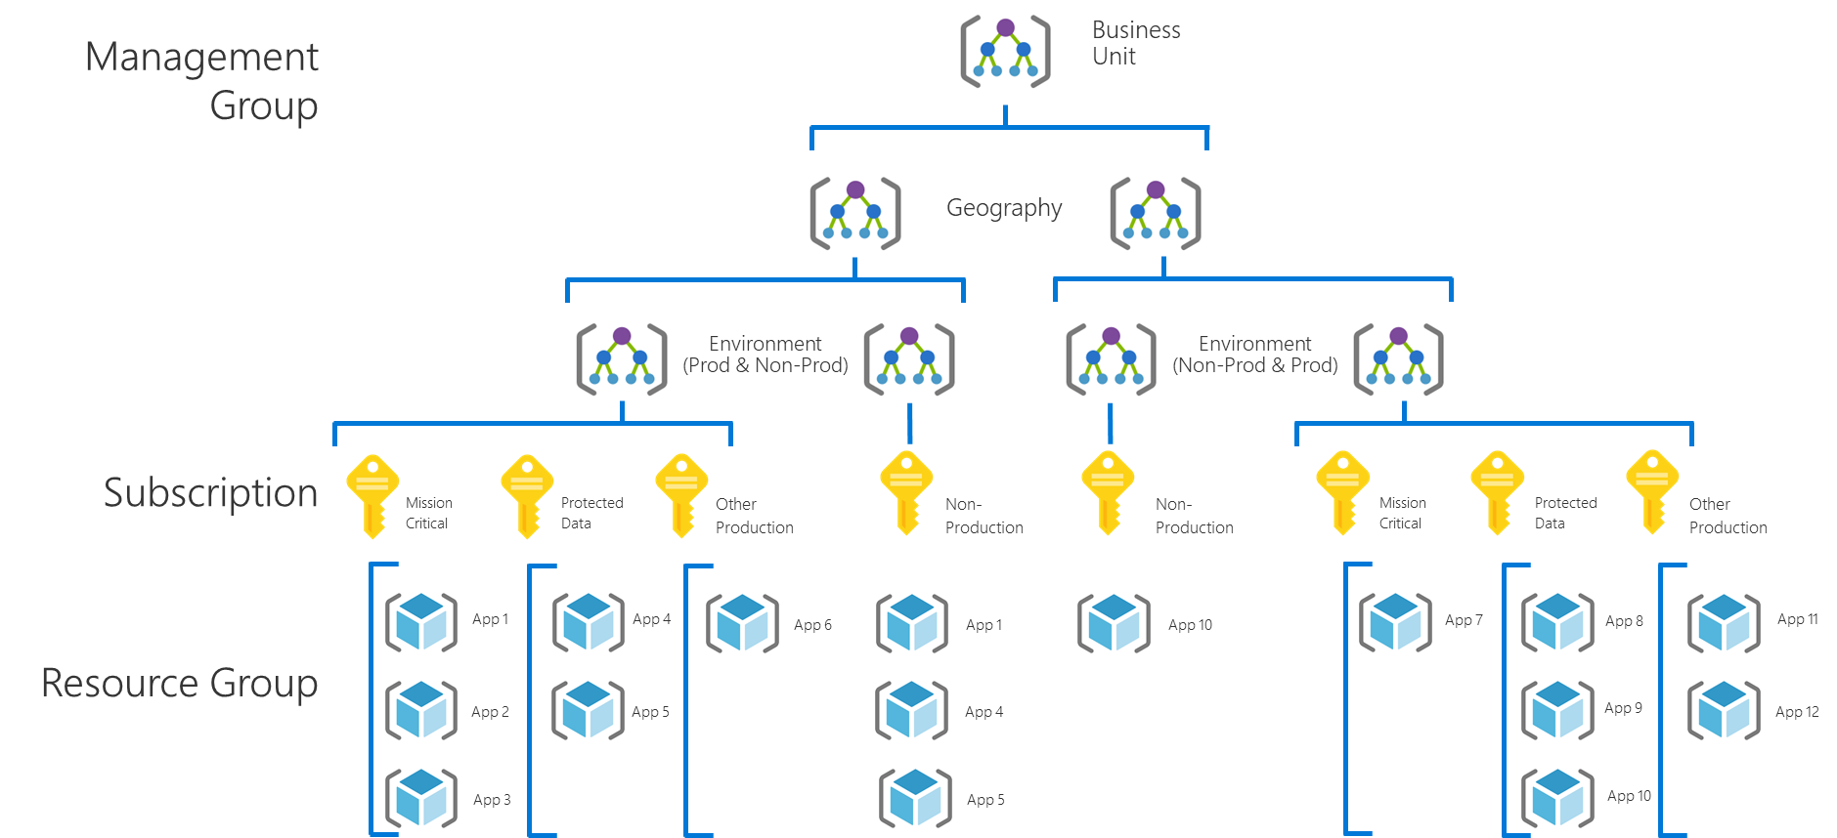
Governance MVP Considerations
Policies
Resource Organization:
Build only what you need, add as the requirements are needed.
Management Group Hierarchy: Business Unit, Geography, Environment.
Subscription: Per Application Category; Pre-production, Dev environments, Production
Resource Groups: Per Application
Notes:
Standard Enterprise Governance Guide: https://docs.microsoft.com/en-us/azure/cloud-adoption-framework/govern/guides/standard/
Complex Enterprise Governance Guide: https://docs.microsoft.com/en-us/azure/cloud-adoption-framework/govern/guides/complex/

Slide 27
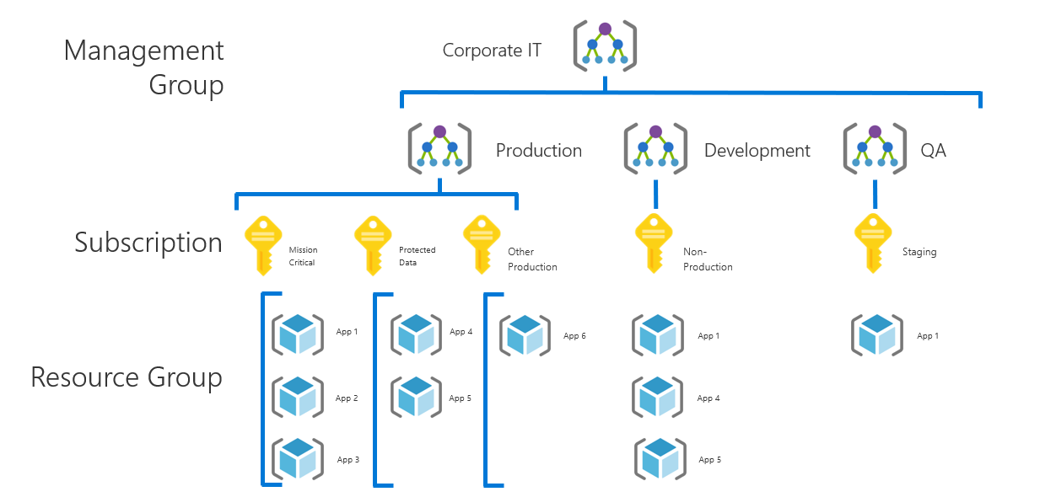
Management Group best practices
Define your hierarchy based on organization and environment type (prod, pre-prod, etc.)
The root MG is for global configuration
Be careful with MG level assignments as they will cascade through large chunks of your hierarchy
Try not to repeat yourself. Assign common policies and RBAC higher up in your hierarchy
Built-in RBAC roles for MGs (MG contributor, MG reader)
Need subscription owner access to move to another MG
Notes:
Standard Enterprise Governance Guide: https://docs.microsoft.com/en-us/azure/cloud-adoption-framework/govern/guides/standard/
Complex Enterprise Governance Guide: https://docs.microsoft.com/en-us/azure/cloud-adoption-framework/govern/guides/complex/

Slide 28
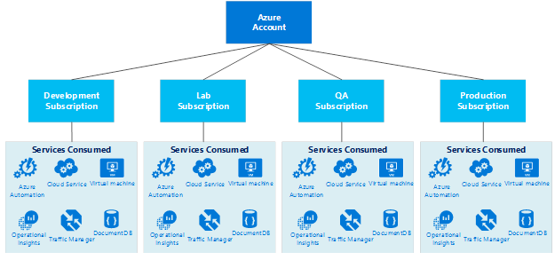
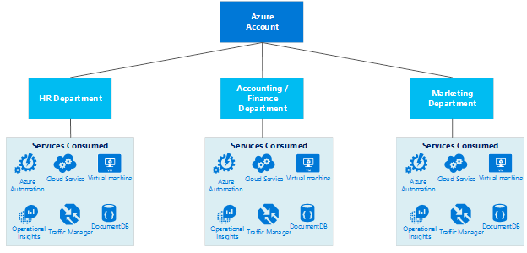
Subscription | Design considerations
Develop the Subscription, Network, Storage, Availability and Administrative models together in order to have a cohesive approach.
Service (Process) Design Model
Organizational Unit Design Model
Items to look at when designing the subscription model
Business Requirements
Accountability
Audit/Compliance
Performance
Availability & Recoverability
Technical Requirements
Network Connectivity (shared or dedicated)
Active directory requirements, clustering, identity, management tools
Security Requirements
Who are the subscription administrators
Least privilege model
Scalability Requirements
Growth plans
Allocation of limited resources
Evolution over time (users, shared access, resource limits)
Notes:
Standard Enterprise Governance Guide: https://docs.microsoft.com/en-us/azure/cloud-adoption-framework/govern/guides/standard/
Complex Enterprise Governance Guide: https://docs.microsoft.com/en-us/azure/cloud-adoption-framework/govern/guides/complex/

Slide 29
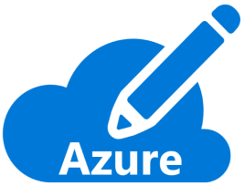
Organize Subscriptions
Ask yourself the following questions:
Are there any capacity / technical limitations?
Do we want to ensure separation of concerns? In example:
Separation of duties
Dev/Test Vs. Production
Different end customers
Different departments or business units
Different projects
What is the right naming convention to be used?
i.e.: <Company> <Department (optional)> <Product Line (optional)> <Environment>
Use a dedicated subscription for shared infrastructure (i.e. Azure Active Directory, monitoring & patching tools…). You will be able to spread the cost of this mutualized infrastructure to app owners.
Different departments or business units
Different projects
Notes:
Standard Enterprise Governance Guide: https://docs.microsoft.com/en-us/azure/cloud-adoption-framework/govern/guides/standard/
Complex Enterprise Governance Guide: https://docs.microsoft.com/en-us/azure/cloud-adoption-framework/govern/guides/complex/

Slide 30

Single subscriptions vs multiple | Considerations
Subscriptions have different quota limits for different resource types
At a certain level of usage you will need to create new subscriptions to scale out, so you need to have a strategy for doing so
A very crucial workflow that can slow down a lot of organizations
Some questions you’ll need to answer:
Who will be responsible for creating subscriptions?
What resources will be in a subscription by default?
Subscription A
Subscription B
Subscription C
…
Notes:
Standard Enterprise Governance Guide: https://docs.microsoft.com/en-us/azure/cloud-adoption-framework/govern/guides/standard/
Complex Enterprise Governance Guide: https://docs.microsoft.com/en-us/azure/cloud-adoption-framework/govern/guides/complex/

Slide 31




Resource Groups, Tags and RBAC
Finance/Business
Need to be able to break out costs by various dimensions such as Customer, Cost Center, Environment
Create Roles with Appropriate Permissions
Resources in a RG should be tagged as needed
Always Tag!
Owner
Dept.
Environment
Application
(Cost Center)
Best Practices on using Resource Tags: https://azure.microsoft.com/documentation/articles/resource-group-using-tags/
Custom RBAC Roles: https://azure.microsoft.com/documentation/articles/role-based-access-control-custom-roles/
Manage tag governance with Policy: https://docs.microsoft.com/azure/governance/policy/tutorials/govern-tags
Notes:
Resource in an RG should always be tagged as a best practice.
Resource Tagging – REF: https://docs.microsoft.com/en-us/azure/cloud-adoption-framework/decision-guides/resource-tagging/

Slide 32
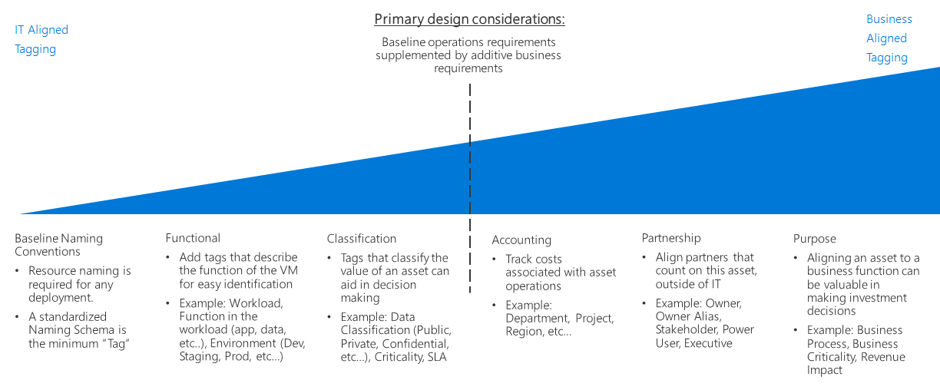
Tagging Decision Guide
Notes:
Resource Tagging – REF: https://docs.microsoft.com/en-us/azure/cloud-adoption-framework/decision-guides/resource-tagging/

Slide 33
Tagging data classification in Azure
The data classification process categorizes data by sensitivity and business impact to identify risks. This protects important data from theft or loss.
The following is a list of classifications Microsoft uses. Depending on your industry, these may already exist within your organization.
Non-business: Data from your personal life that doesn't belong to Microsoft.
Public: Business data that is freely available and approved for public consumption.
General: Business data that isn't meant for a public audience.
Confidential: Business data that can cause harm to Microsoft if overshared.
Highly confidential: Business data that would cause extensive harm to Microsoft if overshared.
Tagging data classification in Azure:
Resource tags are a good approach for metadata storage and can be used to apply data classification information to deployed resources. Although tagging cloud assets by classification isn't a replacement for a formal data classification process, it provides a valuable tool for managing resources and applying policy.
Notes:
Resource Tagging – REF: https://docs.microsoft.com/en-us/azure/cloud-adoption-framework/decision-guides/resource-tagging/

Slide 34



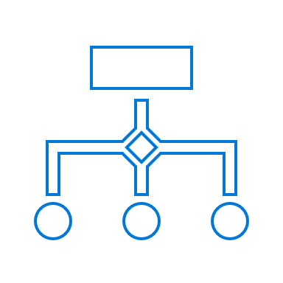
Exercise 1 | Design Working Session
Questions to drive discussion
What are your current rules for metadata tagging of resources and data?
Who will be responsible for creating subscriptions and management groups?
Will you have different governance rules for specific groups in the company?
What are the regulatory rules you need to adhere to?
How are you monitoring workload health and policy compliance violations?
Classification of mission critical apps and data need to be protected
Implement: (Azure portal):
Management groups
Policy
Groups and roles
Design:
Management groups
Subscriptions
Resource groups
Applications
Policies
Roles and groups

Slide 35
Sample policies
All deployed assets must be categorized by criticality and data classification.
Subnets containing mission-critical applications must be protected by a firewall solution capable of detecting intrusions and responding to attacks.
Governance tooling must audit and enforce network configuration requirements defined by the Security Management team.
Governance tooling must validate that all assets related to mission-critical apps or protected data are included in monitoring for resource depletion and optimization.
Governance tooling must validate that the appropriate level of logging data is being collected for all mission-critical applications or protected data.
Governance process must validate that backup, recovery, and SLA adherence are properly implemented for mission-critical applications and protected data.

Slide 36
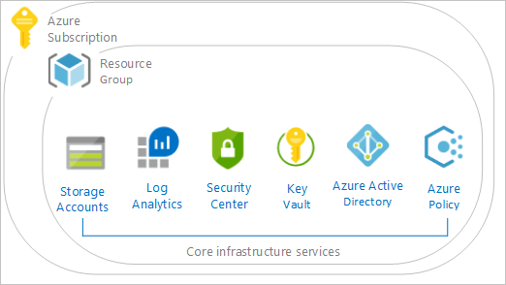
Deploy the policies using Azure blueprints to create Governance MVP
Cloud Adoption Framework Foundation blueprint deploys recommended infrastructure resources to put in place the foundation controls necessary to manage the cloud estate.
This environment is composed of:
An Azure Key Vault
Deploy Log Analytics
Deploy Azure Security Center (standard version)
The blueprint also defines and deploys Azure Policies, for
Tagging (CostCenter) applied to resources groups
Append resources in resource group with the CostCenter Tag
Allowed Azure Region for Resources and Resource Groups
Allowed Storage Account SKUs (choose while deploying)
Allowed Azure VM SKUs (choose while deploying)
Require Network Watch to be deployed
Require Azure Storage Account Secure transfer Encryption
Deny resource types (choose while deploying)
Initiatives
Enable Monitoring in Azure Security Center (89 Policies)

Slide 37
Where to go for more information
Best Practices on using Resource Tags
Organize your resources with Azure management groups
CAF aligned Azure Blueprints

Slide 38
Resource Consistency Discipline Activities
Define Azure Management Groups & Subscriptions model & RACI
Define resource consistency roles & responsibilities
Define Resource Consistency Policies (Naming Conventions | Operational Tagging | Allowed Locations | Allowed Resource Types | Allowed Extensions | Auditing)
Notes:
Standard Enterprise Governance Guide: https://docs.microsoft.com/en-us/azure/cloud-adoption-framework/govern/guides/standard/
Complex Enterprise Governance Guide: https://docs.microsoft.com/en-us/azure/cloud-adoption-framework/govern/guides/complex/

Slide 39
Workshop Lab B - Govern Building a Cloud Governance MVP
Deploy the CAF Foundation landing zone blueprint to your subscription - https://docs.microsoft.com/en-us/azure/governance/blueprints/samples/caf-foundation/
Based on the Customer situation and Customer needs (next slides) prioritize and implement Resource consistency.
Notes:
Standard Enterprise Governance Guide: https://docs.microsoft.com/en-us/azure/cloud-adoption-framework/govern/guides/standard/
Complex Enterprise Governance Guide: https://docs.microsoft.com/en-us/azure/cloud-adoption-framework/govern/guides/complex/

Slide 40
Customer Needs—Resource Consistency
Allow the Cloud Governance team to control which Azure services can be used across the business units, while allowing controlled exceptions
Control resource types and expensive configurations within common resource types
Restrict Resourcegroup creation to approved groups
Exceptions must be limited to a specific resource type and resource group
Prevent accidental deletion of resources
Implement a common resource naming standard across the organization
Notes:
While the Cloud Governance team is not yet familiar with the full range of Azure services available. They want to limit Azure adoption to an initial set of core services and locations, which will be expanded over time. These should be centrally enforced, with the ability to grant exceptions where required (for example, for teams piloting new technologies, or one-off deployments of a shared resource such as an ExpressRoute circuit).
The IT Security team is particularly concerned about production environments. These require additional controls to ensure that resources cannot be accidentally modified or deleted by administrators getting confused between a test workload versus production.
To maintain consistency, the Cloud Governance team is developing a set of naming conventions. These names will apply to subscriptions, resource groups and resources. Trey require the ability to enforce this naming convention consistently across their Azure subscriptions.
Standard Enterprise Governance Guide: https://docs.microsoft.com/en-us/azure/cloud-adoption-framework/govern/guides/standard/
Complex Enterprise Governance Guide: https://docs.microsoft.com/en-us/azure/cloud-adoption-framework/govern/guides/complex/

Slide 41
Customer Needs—Resource Consistency Control Backlog
Rules that are too permissive may allow unintended network access and should be reviewed. Monitor unprotected endpoints, applications, and storage accounts. Endpoints and applications that aren't protected by a firewall, and storage accounts with unrestricted access can allow unintended access to information contained within the information system.
Audit unrestricted network access to storage accounts
Access through Internet facing endpoint should be restricted
Allowed locations
Allowed locations for resource groups
Audit use of classic storage accounts
Audit use of classic virtual machines
Audit VMs that do not use managed disks
Notes:
While the Cloud Governance team is not yet familiar with the full range of Azure services available. They want to limit Trey's Azure adoption to an initial set of core services and locations, which will be expanded over time. These should be centrally enforced, with the ability to grant exceptions where required (for example, for teams piloting new technologies, or one-off deployments of a shared resource such as an ExpressRoute circuit).
The IT Security team is particularly concerned about production environments. These require additional controls to ensure that resources cannot be accidentally modified or deleted by administrators getting confused between a test workload versus production.
To maintain consistency, the Cloud Governance team is developing a set of naming conventions. These names will apply to subscriptions, resource groups and resources. Trey require the ability to enforce this naming convention consistently across their Azure subscriptions.
Standard Enterprise Governance Guide: https://docs.microsoft.com/en-us/azure/cloud-adoption-framework/govern/guides/standard/
Complex Enterprise Governance Guide: https://docs.microsoft.com/en-us/azure/cloud-adoption-framework/govern/guides/complex/

Slide 42
Cost Management

Slide 43
Workshop | Creating the cost mgmt. baseline
Estimated time frame: approx. ~ 2hrs
Participants:
Finance, cost center owners, application owners, IT teams
Outcomes:
Budget setup, cost analysis, view bills and invoices, scope
Requirements:
Management group, subscriptions and tagging
Triggers:
Concerned about budgets
Cost allocation across business units
Need to implement cost guardrails
Need to analyze cost of an application
Notes:
A basic slide to outine each mini-workshop…
Cost Management – REF: https://docs.microsoft.com/en-us/azure/cloud-adoption-framework/govern/cost-management/

Slide 44

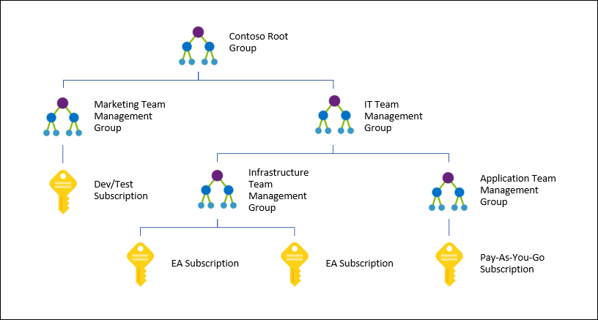

Let’s outline cost management
Continuous cost optimization process
Optimization
MG to govern tags Used as a cost scope for budget and Cost Analysis
Tags for visibility cross scopes
Monitor
Accountability
Management teams
Finance teams
App teams
Notes:
Cost Management – REF: https://docs.microsoft.com/en-us/azure/cloud-adoption-framework/govern/cost-management/

Slide 45
Azure Cost Management
Management Groups
Tags
Action Groups
Cost Management in Azure
Always on by default, no setup needed
Data hygiene for tags and policies
Optimize through Azure Advisor
Notifications through action groups
RBAC and management groups ensures better access controls
Manage AWS costs and usage in Azure
RBAC
Advisor
ACM
ARM
Policy
Notes:
A major benefit of having cost management in the Azure Portal is that now you can take advantage of deep integration with a variety of Azure services that make your experience even better.
You can take advantage of policy to help you with tagging you resources and be able to do better cost analysis.
Azure management groups and RBAC allow you to ensure better access controls to your data.
Implement notifications through action groups, which will help with budgets.
Azure Advisor is now integrated in Azure Cost Management too, giving you suggestions on how to optimize your workloads through things like right sizing, reserved instances or eliminating idle resources.
This is the power of being part of the Azure platform.
built on top of ARM,
RBAC
Cost Management – REF: https://docs.microsoft.com/en-us/azure/cloud-adoption-framework/govern/cost-management/

Slide 46

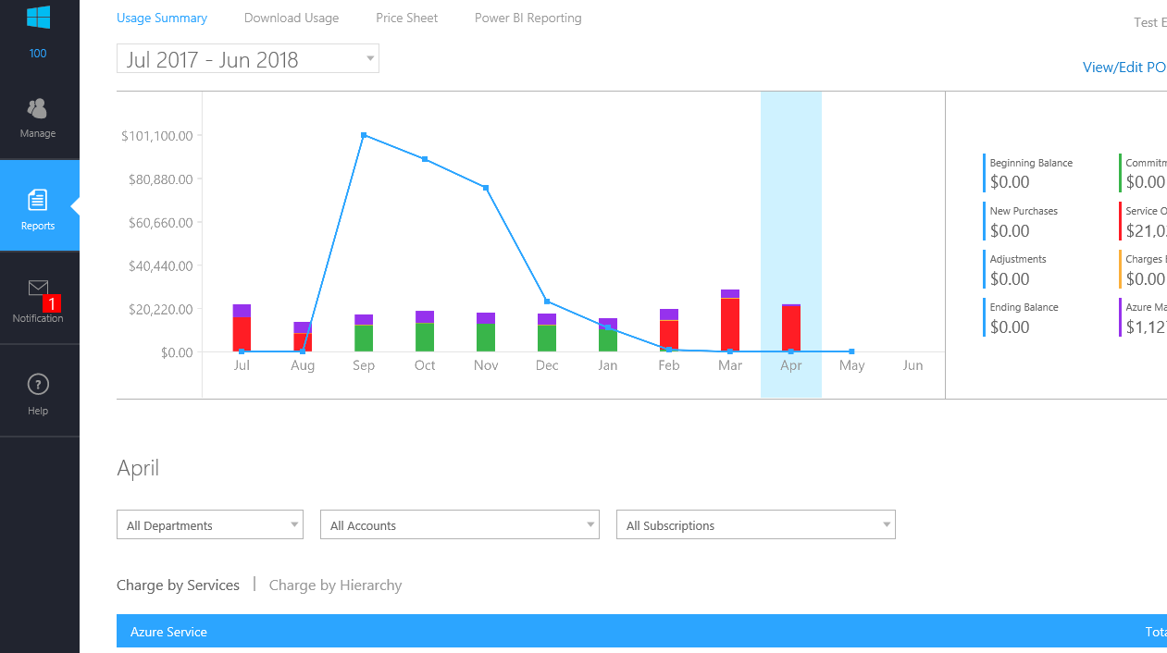
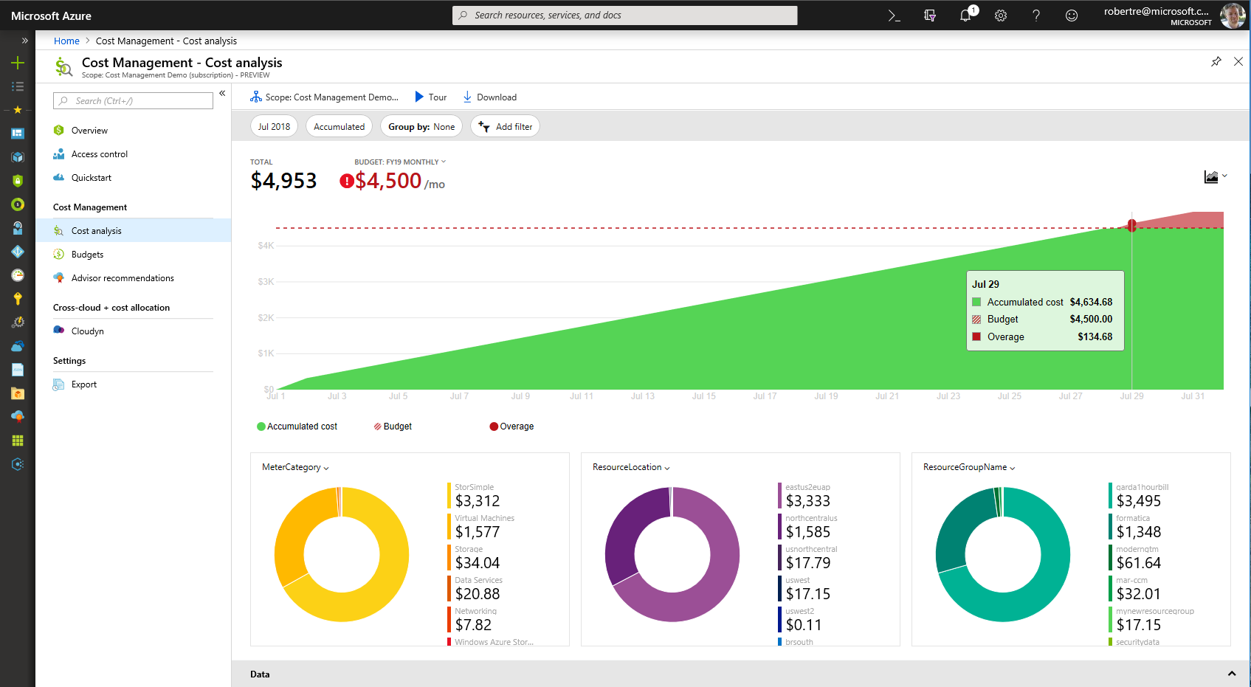
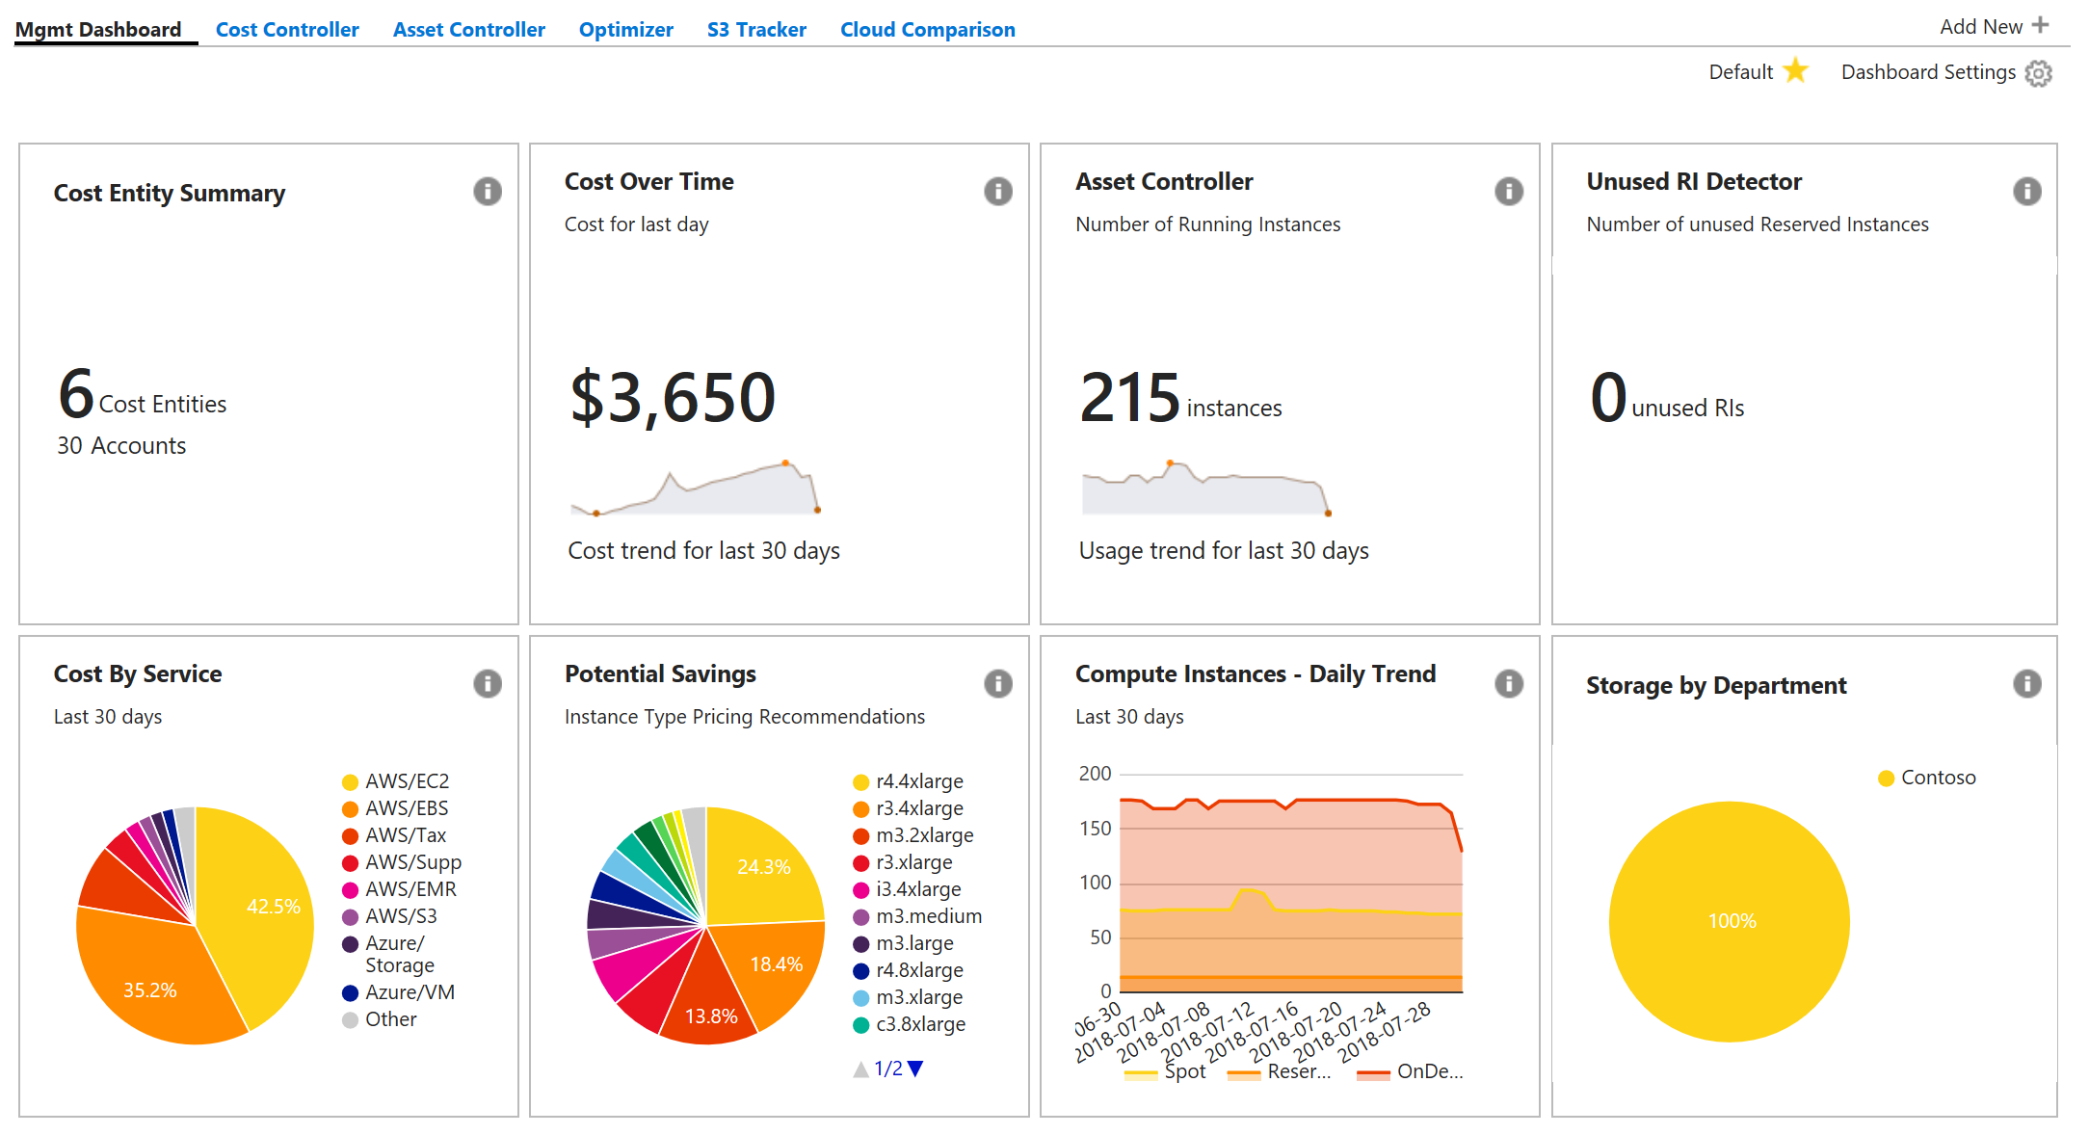
Bring the best together in Azure Portal
Enterprise Portal
Azure Cost Management
Cost Management By Cloudyn
Notes:
Reducing # of portals…and we will cover details in upcoming slides..
Cost Management – REF: https://docs.microsoft.com/en-us/azure/cloud-adoption-framework/govern/cost-management/

Slide 47
Cost management solutions for a variety of needs
Cost Management
in Azure Portal
Connectors to PowerBI
Azure APIs
Ready to use
Custom dashboards
Custom solutions
Notes:
Azure Cost Management is a ready to go service, but we understand that you may want to customize your cost management experience and that is why we are providing connectors for PowerBi and access to the cost management APIs.
Now you can customize your own dashboard on PowerBI, and use the APIs to integrate it with your existing applications.
With Azure Cost Management, we want to make sure that we provide al the tools necessary for your needs and that is why we cover this spectrum.
Cost Management – REF: https://docs.microsoft.com/en-us/azure/cloud-adoption-framework/govern/cost-management/

Slide 48
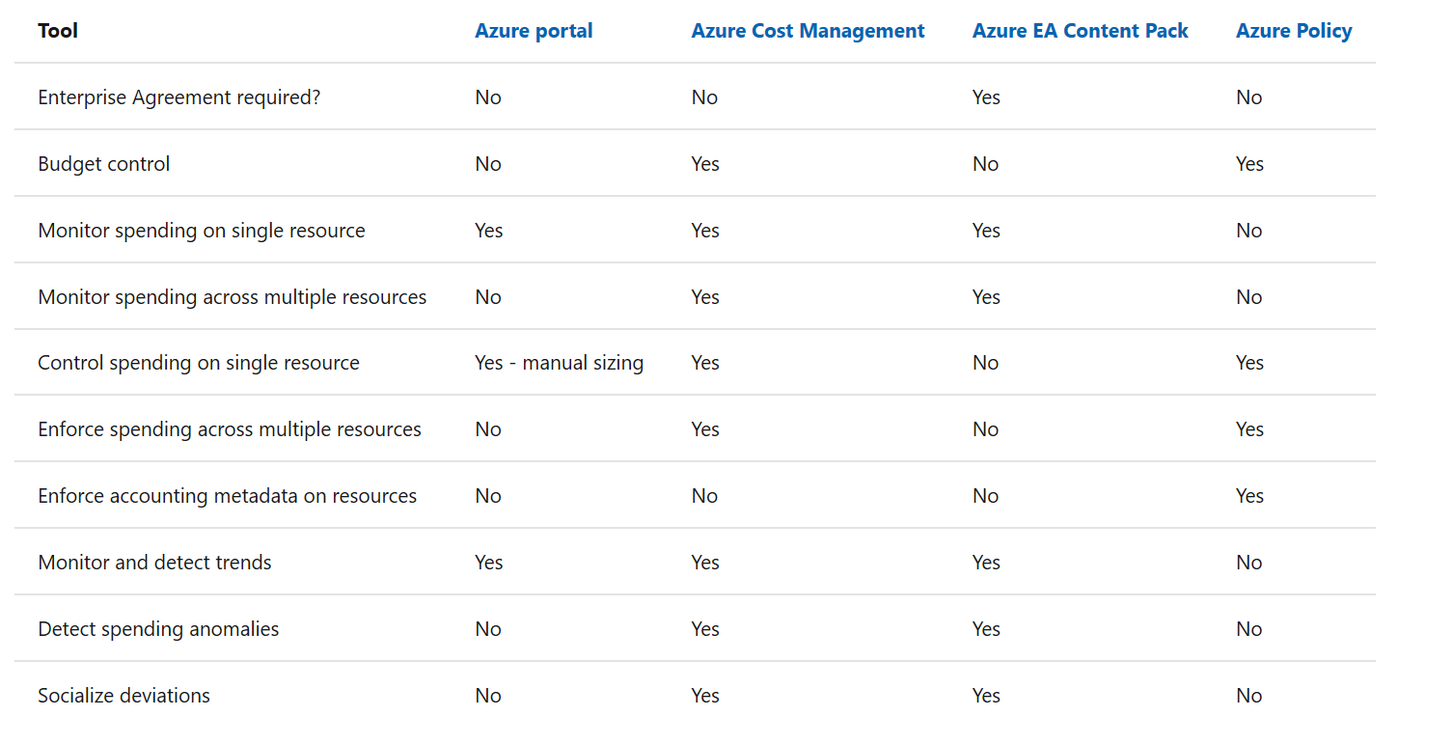
Cost Management tools in Azure
The following is a list of Azure native tools that can help mature the policies and processes that support this governance discipline.
Notes:
Cost Management – REF: https://docs.microsoft.com/en-us/azure/cloud-adoption-framework/govern/cost-management/

Slide 49
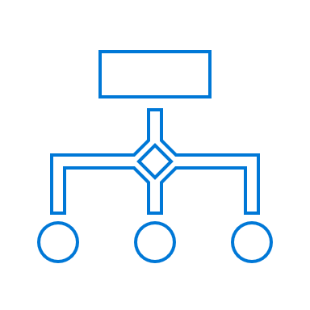
Exercise | Defining cost policies
How are you landing accountability of budget?
Are you going to allow the use of any Azure service / resource?
What are the policies around budget over-run?
What is the cadence in the business to set, review, adjust and optimize on budgets?
Will there be different policies for spend based on internal use or a potential to impact customer experience?
Notes:
Cost Management – REF: https://docs.microsoft.com/en-us/azure/cloud-adoption-framework/govern/cost-management/
Billing tags policy initiative - REF - https://docs.microsoft.com/en-us/azure/governance/policy/samples/billing-tags-policy-initiative

Slide 50
Sample policies
Modify CostCenter Tag & Its value from Resource Group
Modify CostCenter Tag to Resource Groups
For tracking purposes, all assets must be assigned to an application owner within one of the core business functions.
When cost concerns arise, additional governance requirements will be established with the finance team.
Allowed Azure Region for Resources and Resource Groups​
Allowed Azure VM SKUs

Slide 51
Where to go for more information
Cloud Adoption Framework – Cost Management
https://docs.microsoft.com/en-us/azure/cloud-adoption-framework/govern/cost-management/
Azure Cost Management product page
https://azure.microsoft.com/services/cost-management/
Azure Cost Management documentation
https://docs.microsoft.com/azure/cost-management/
Azure Cost Management API reference
https://docs.microsoft.com/rest/api/cost-management/
FastTrack for Azure (deployment guidance)
https://azure.microsoft.com/programs/azure-fasttrack/

Slide 52
Cost Management Discipline Activities
Define Enterprise Enrollment Hierarchy Process & RACI
Define Azure Cost Management Budgets & Alerts + RACI
Define Cost Management RBAC Model
Define Cost Management Policies (Tagging | Allowed VM SKUs | Allowed Storage SKUs | Allowed Networking SKUs | Allowed Database SKUs)

Slide 53
Workshop Lab B - Govern Building a Cloud Governance MVP
Deploy the CAF Foundation landing zone blueprint to your subscription - https://docs.microsoft.com/en-us/azure/governance/blueprints/samples/caf-foundation/
Based on the Customer situation and Customer needs (next slides) prioritize and implement Cost Management.
Notes:
Cost Management – REF: https://docs.microsoft.com/en-us/azure/cloud-adoption-framework/govern/cost-management/

Slide 54
Customer Needs—Cost Management
Provide cost management tools for budgets, alerts, dashboards, spending reports, forecasts, anomaly detection and investigation, and cost-saving recommendations
Implement a charge back mechanism for the business units for resources they consume based on the IO code for each application
Enable allocation of costs between categories: Development and Test, Production, Support Services, and Infrastructure
Notes:
Each business unit and subunit is allocated an Azure quota/budget and is responsible for tracking their expenditure within that budget. Within a business unit, each new project should track its consumption using a specific tag for its IO code within the business unit.
In addition, each business unit has a requirement to break down their costs into the following categories. Accurate allocation of costs between this categories is essential, since this data feeds into gross margin and net profit figures collated by the central finance team and published quarterly to investors.
- Development and Test
- Production
- Support Services
- Infrastructure
Business units and the finance department need tools to accurately and reliably track all Azure costs, including a cost management dashboard and reports to understand current costs and projected future costs. Alerts when budgets are approached or exceeded are required.
In addition, the Cloud Governance team's charter includes company-wide monitoring and reporting of all Azure spend, including reviewing usage to identify cost-saving opportunities and identifying and investigating anomalous spending.

Slide 55
Customer Needs—Cost Management Controls Backlog
You should associate all assets deployed to the cloud with a billing unit and application/workload. This policy will ensure that future Cost Management efforts will be effective.
Notes:
Each business unit and subunit is allocated an Azure quota/budget and is responsible for tracking their expenditure within that budget. Within a business unit, each new project should track its consumption using a specific tag for its IO code within the business unit.
In addition, each business unit has a requirement to break down their costs into the following categories. Accurate allocation of costs between this categories is essential, since this data feeds into gross margin and net profit figures collated by the central finance team and published quarterly to investors.
- Development and Test
- Production
- Support Services
- Infrastructure
Business units and the finance department need tools to accurately and reliably track all Azure costs, including a cost management dashboard and reports to understand current costs and projected future costs. Alerts when budgets are approached or exceeded are required.
In addition, the Cloud Governance team's charter includes company-wide monitoring and reporting of all Azure spend, including reviewing usage to identify cost-saving opportunities and identifying and investigating anomalous spending.

Slide 56
Build the Identity Baseline

Slide 57
Workshop | Creating the Identity mgmt. baseline
Estimated time frame: approx. ~ 2hrs
Participants: Cloud Architects
Outcomes:
Management groups, subscriptions, RBAC
Requirements:
Understanding of internal org structures, compliance requirements?
Triggers:
Getting started with Azure and need help in cloud environment setup
Interested in learning about best practices in resource management in Azure
Notes:
A basic slide to outine each mini-workshop…
https://docs.microsoft.com/en-us/azure/cloud-adoption-framework/govern/identity-baseline/

Slide 58
Identity Management and Access Control Best Practices
Treat identity as the primary security perimeter
Centralize Identity Management
Manage connected tenants
Enable single sign-on
Turn on conditional access
Plan for routine security improvements
Enable password management
Enable multifactor verification for users
Use role-based access control
Lower exposure of privileged accounts
Control locations where resources are created
Actively monitor for suspicious activities
Use Azure AD for storage authentication
Central to protecting your data and assets in the cloud is a combination of identity management and access control. Here are some of the key practices to follow:
Learn more: Azure Identity Management and access control security best practices.

Slide 59
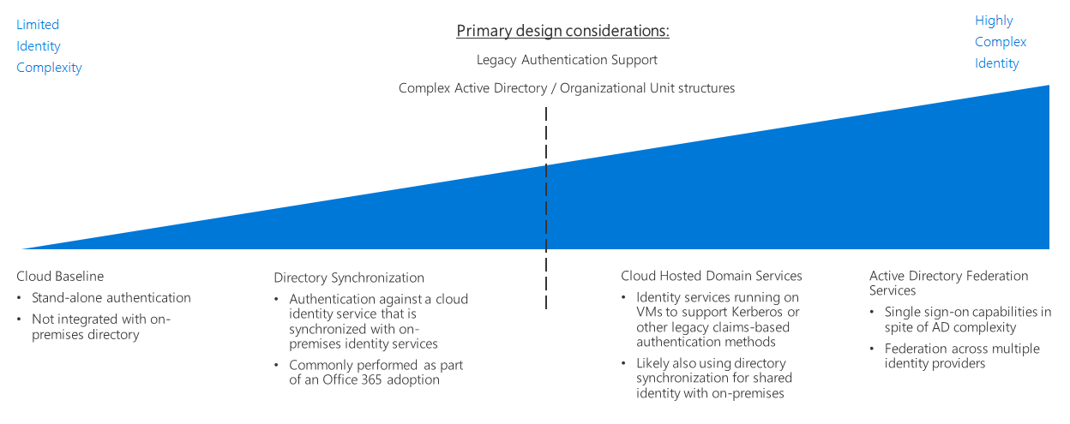
Identity management decision guide
Several options are available for managing identity in a cloud environment which vary in cost and complexity.
A key factor in structuring your cloud-based identity services is the level of integration required with your existing on-premises identity infrastructure.
Cloud-based identity management is an iterative process.
Notes:
https://docs.microsoft.com/en-us/azure/cloud-adoption-framework/govern/identity-baseline/

Slide 60
Identity management patterns
 | Cloud Baseline (Azure AD) | Directory Synchronization | Cloud-hosted domain services | Active Directory Federation Services
When to use | Organization lacks an on-premises identity solution, and plans on migrating workloads to be compatible with cloud-based authentication mechanisms | For organizations with existing on-premises Active Directory infrastructure; best solution for preserving existing user and access management | Workloads that depend on claims-based authentication using legacy protocols such as Kerberos or NTLM, and they cannot be refactored to accept modern authentication protocols such as SAML or OAuth and OpenID Connect. | Identity federation establishes trust relationships across multiple identity management systems to allow common authentication and authorization capabilities.
Assumptions | Cloud-based resources will not have dependencies on on-premises directory services or Active Directory servers Workloads being migrated either support authentication mechanisms compatible with Azure AD Existing workloads that depend on legacy authentication methods such as Kerberos might need to be refactored | You need to maintain a common set of user accounts and groups across your cloud and on-premises IT infrastructure. Your on-premises identity services support replication with Azure AD. | Your workloads depend on claims-based authentication using protocols like Kerberos or NTLM. Your workload virtual machines need to be domain-joined for management or application of Active Directory group policy purposes. | You need single sign on capability across multiple identity management systems
Learn more
Notes:
https://docs.microsoft.com/en-us/azure/cloud-adoption-framework/govern/identity-baseline/

Slide 61
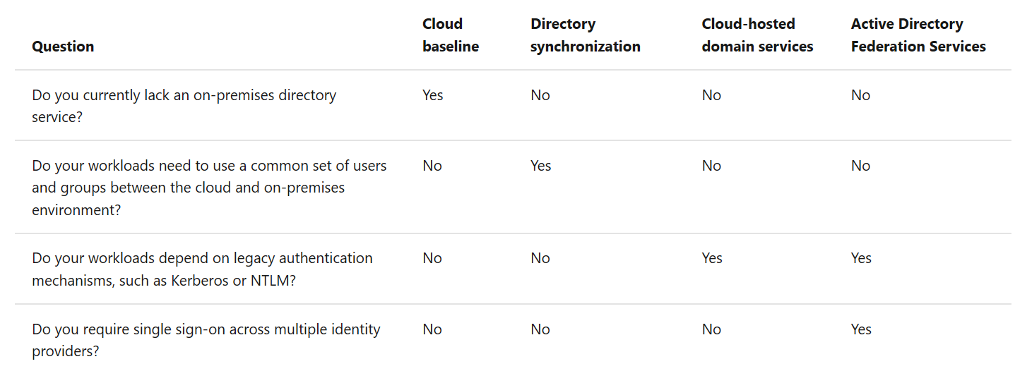
Determine Identity Integration Requirements
Start with a cloud-native solution with a small set of users and corresponding roles for an initial deployment.
As your migration matures, integrate your identity solution using directory synchronization or add domains services as part of your cloud deployments.
Revisit your identity strategy in every iteration of your migration process.
Notes:
https://docs.microsoft.com/en-us/azure/cloud-adoption-framework/govern/identity-baseline/

Slide 62
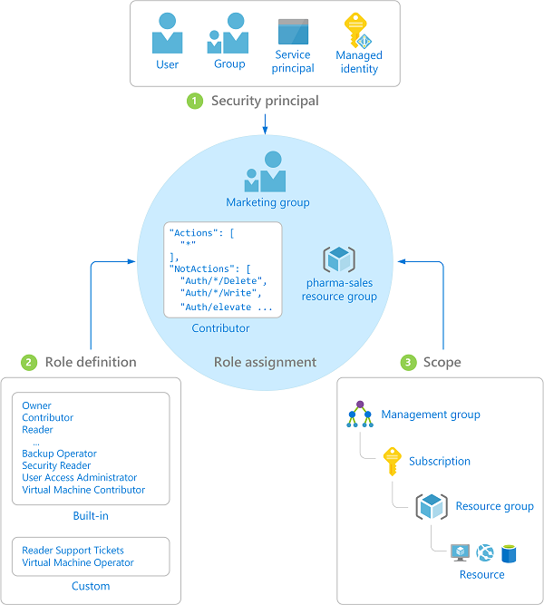
Azure Role-Based Access Control (RBAC)
Fine-grained access control to Azure “control plane”
Grant access by assigning Security Principal a Role at a Scope
Security Principal: User, group, or service principal
Role: Built-in or custom role
Scope: Subscription, resource group, or resource
Assignments are inherited down the resource hierarchy
Learn more https://aka.ms/azureiam
Notes:
Using RBAC, you can segregate duties within your team and grant only the amount of access to users that they need to perform their jobs. Instead of giving everybody unrestricted permissions in your Azure subscription or resources, you can allow only certain actions at a particular scope.
<CLICK1>
Security principal
A security principal is an object that represents a user, group, service principal, or managed identity that is requesting access to Azure resources.
- Service principal - A security identity used by applications or services to access specific Azure resources. You can think of it as a user identity (username and password or certificate) for an application.
Managed identity - An identity in Azure Active Directory that is automatically managed by Azure. You typically use managed identities when developing cloud applications to manage the credentials for authenticating to Azure services.
<CLICK2>
Role definition
A role definition is a collection of permissions. It's sometimes just called a role. A role definition lists the operations that can be performed, such as read, write, and delete. Roles can be high-level, like owner, or specific, like virtual machine reader. You can create custom roles if none of the existing built-in roles don't meet the specific needs of your organization.
<CLICK3>
Scope
Scope is the boundary that the access applies to. When you assign a role, you can further limit the actions allowed by defining a scope. This is helpful if you want to make someone a Website Contributor, but only for one resource group.

Slide 63
Role Based Access Control
Notes:
RBAC for Azure resources documentation – REF: https://docs.microsoft.com/en-us/azure/role-based-access-control/

Slide 64

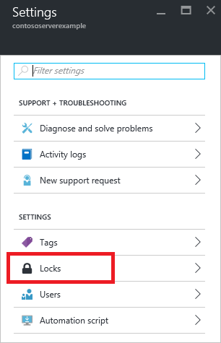
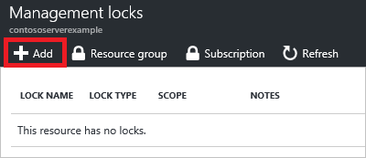
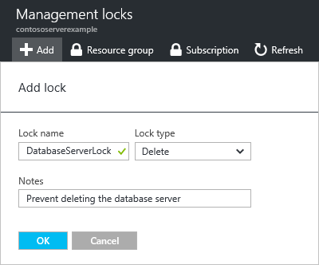
Resource Lock
BEST PRACTICE
CHOICE
Lock a Subscription, resource group, or resource to prevent accidental deletion or modification.
CanNotDelete / ReadOnly
Locks apply only to management operations, not to resources functions
Caution: ReadOnly can cause unexpected results
Lock on a storage account prevents all users from listing keys
Lock on App Service prevents Visual Studio Server Explorer from displaying files for the resource because that interaction requires write access
Notes:
https://docs.microsoft.com/en-us/azure/azure-resource-manager/resource-group-lock-resources
How locks are applied
When you apply a lock at a parent scope, all resources within that scope inherit the same lock. Even resources you add later inherit the lock from the parent. The most restrictive lock in the inheritance takes precedence.
Unlike role-based access control, you use management locks to apply a restriction across all users and roles. To learn about setting permissions for users and roles, see Azure Role-based Access Control.
Resource Manager locks apply only to operations that happen in the management plane, which consists of operations sent to https://management.azure.com. The locks do not restrict how resources perform their own functions. Resource changes are restricted, but resource operations are not restricted. For example, a ReadOnly lock on a SQL Database prevents you from deleting or modifying the database, but it does not prevent you from creating, updating, or deleting data in the database. Data transactions are permitted because those operations are not sent to https://management.azure.com.
Applying ReadOnly can lead to unexpected results because some operations that seem like read operations actually require additional actions. For example, placing a ReadOnly lock on a storage account prevents all users from listing the keys. The list keys operation is handled through a POST request because the returned keys are available for write operations. For another example, placing a ReadOnly lock on an App Service resource prevents Visual Studio Server Explorer from displaying files for the resource because that interaction requires write access.

Slide 65
Workshop | Defining Identity baseline policies
Do you have a consistent way of applying access control?
What are the different roles and functions that you will consider for defining access policies?
Have you done the mapping of on-premise roles to the cloud roles to ensure cloud resources can perform necessary functions
Are you planning on using multi-factor authentication?
As your teams build apps you need to ensure that you have compatible identity providers for customer authentication

Slide 66
Sample policies
All assets deployed to the cloud should be controlled using identities and roles approved by current governance policies.
A least-privilege access model will be applied to any resources involved in mission-critical applications or protected data.
Elevated permissions should be an exception, and any such exceptions must be recorded with the cloud governance team. Exceptions will be audited regularly.
All groups in the on-premises Active Directory infrastructure that have elevated privileges should be mapped to an approved RBAC role.
All accounts are required to sign in to secured resources using a multi-factor authentication method.
Deployment of any applications that require customer authentication must use an approved identity provider that is compatible with the primary identity provider for internal users.

Slide 67
Where to go for more information
Learn more about RBAC
Azure Identity Management Best Practices

Slide 68
Identity Baseline Discipline Activities
Define Azure RBAC Model
Define Azure Access Management Process & RACI
Operationalize Azure Privileged Identity Management

Slide 69
Workshop Lab B - Govern Building a Cloud Governance MVP
Deploy the CAF Foundation landing zone blueprint to your subscription - https://docs.microsoft.com/en-us/azure/governance/blueprints/samples/caf-foundation/
Based on the Customer situation and Customer needs (next slides) prioritize and implement Identity Management.

Slide 70
Customer Needs—Identity Baseline
Delegate access management to business units for each application they own
Business unit administrators should not be able to change or override policies defined by the Cloud Governance team
Ensure staff have access to what they need, but no more, while enforcing that only built-in roles are used
Identify a solution to streamline identity management and provide remote access for e-commerce team contingent staff
Notes:
Trey Research has deployed Office 365 and it is configured with federated access to their ADFS servers. Trey's EA has been created within the same organization.
Providing the ability to delegate permissions to different administrators at the business unit and subunit level is critical. However, for an organization the size of Trey Research, it is not possible for the Cloud Governance team to manage all user permissions centrally. Instead, for each new project, an administrator in the business unit should be able to manage access for his or her team. The business unit administrator must not be able to override or circumnavigate governance rules defined by the Cloud Governance team. Team members must be provide the access they need, to the resources they need, but no more. To maintain consistency and to enable Cloud Governance team audit, Azure access should be controlled using built-in roles only, not custom roles.
The Trey e-commerce team make significant use of contingent staff. At present, these staff are granted identities in the existing Trey directory, and are required to work on-site to gain access to Trey development and test environments. Trey would like to streamline this process and enable remote working.

Slide 71
Customer Needs—Identity Baseline Controls Backlog
[Preview]: Audit deprecated accounts on a subscription
[Preview]: Audit deprecated accounts with owner permissions on a subscription
[Preview]: Audit external accounts with owner permissions on a subscription
[Preview]: Audit external accounts with write permissions on a subscription
Notes:
Trey Research has deployed Office 365 and it is configured with federated access to their ADFS servers. Trey's EA has been created within the same organization.
Providing the ability to delegate permissions to different administrators at the business unit and subunit level is critical. However, for an organization the size of Trey Research, it is not possible for the Cloud Governance team to manage all user permissions centrally. Instead, for each new project, an administrator in the business unit should be able to manage access for his or her team. The business unit administrator must not be able to override or circumnavigate governance rules defined by the Cloud Governance team. Team members must be provide the access they need, to the resources they need, but no more. To maintain consistency and to enable Cloud Governance team audit, Azure access should be controlled using built-in roles only, not custom roles.
The Trey e-commerce team make significant use of contingent staff. At present, these staff are granted identities in the existing Trey directory, and are required to work on-site to gain access to Trey development and test environments. Trey would like to streamline this process and enable remote working.

Slide 72
Build the Security Baseline

Slide 73
Workshop | Implementing security baseline
Estimated time frame: Approx 2hrs
Participants:
Security team, compliance, application owners, IT teams
Outcomes:
Clear set of baseline policies to protect assets and resources.
Triggers:
Customer is blocked for security concerns
The CSO would like to understand security guardrails in Azure
Pre-requisite
Management group, RBAC, hub & spoke, subscriptions and tagging
Notes:
A basic slide to outine each mini-workshop…

Slide 74
What is Security Baseline?
This discipline focuses on ways of establishing policies that protect the network, assets, and data that will reside on a cloud provider's solution.
It also includes documentation of risks, business tolerance, and mitigation strategies associated with the security of the data, assets, and network.
From a technical perspective, this includes making decisions regarding network requirements, hybrid identity strategies, encryption and the processes used to develop cloud Security Baseline policies.
Notes:
Security Baseline – REF: https://docs.microsoft.com/en-us/azure/cloud-adoption-framework/govern/security-baseline/

Slide 75
Potential activities to create security baseline
Determine your organization's encryption strategy for cloud-hosted data.
Evaluate your cloud deployment's identity strategy. Determine how your cloud-based identity solution will coexist or integrate with on-premises identity providers.
Determine network boundary policies for your Software Defined Networking (SDN) design to ensure secure virtualized networking capabilities.
Evaluate your organization's least-privilege access policies,and use task-based roles to provide access to specific resources.
Apply security and monitoring mechanisms to all cloud services and virtual machines.
Automate security policies where possible.
Notes:
Security Baseline – REF: https://docs.microsoft.com/en-us/azure/cloud-adoption-framework/govern/security-baseline/
Encryption Decision Guide – REF: https://docs.microsoft.com/en-us/azure/cloud-adoption-framework/decision-guides/encryption/
Identity Decision Guide – REF: https://docs.microsoft.com/en-us/azure/cloud-adoption-framework/decision-guides/identity/
Software Defined Networking – REF: https://docs.microsoft.com/en-us/azure/cloud-adoption-framework/decision-guides/software-defined-network/
Least-privilege access – REF: https://docs.microsoft.com/azure/active-directory/users-groups-roles/roles-delegate-by-task
Automate Security Policies – REF: https://docs.microsoft.com/en-us/azure/cloud-adoption-framework/decision-guides/policy-enforcement/

Slide 76
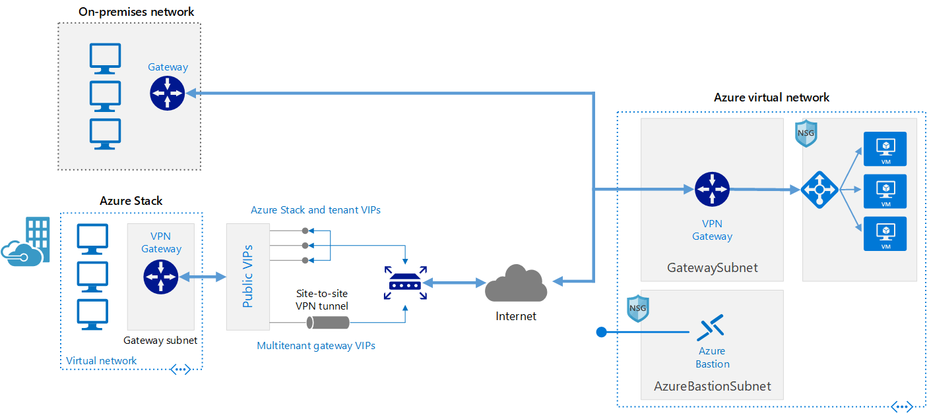
Network Security | Secure hybrid VNet
Subscriptions often require some level of access to on-premises resources. This is common in migration scenarios.
It is important to control and monitor any allowed communication between on-premises environment and cloud workloads,
The On-premises network has to be secured against potential unauthorized access from cloud-based resources.
This reference architecture shows how to extend a network from on premises or from Azure Stack into an Azure virtual network, using a site-to-site virtual private network (VPN).

Slide 77
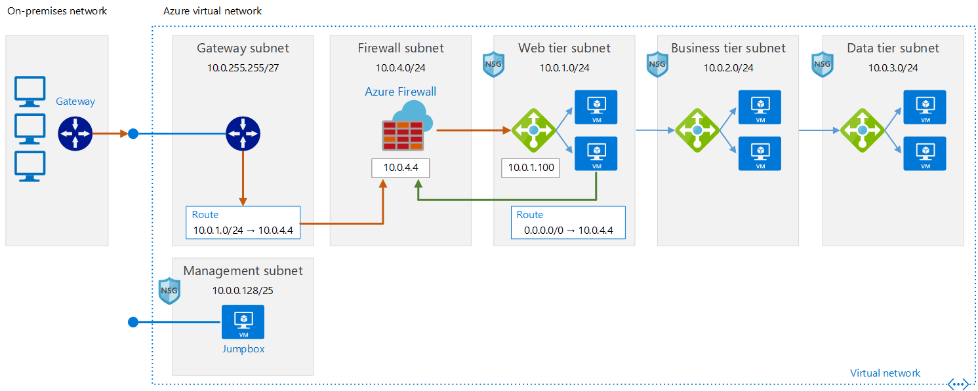
Cloud DMZ networking pattern A pattern for a “maturing” security baseline
This architecture is designed to support scenarios where your organization wants to start integrating cloud-based workloads with on-premises workloads but may not have fully matured cloud security policies or acquired a secure dedicated WAN connection between the two environments. As a result, cloud networks should be treated like a demilitarized zone to ensure on-premises services are secure.
Learn more about Software Designed Networks patterns

Slide 78
Identity management | Decision guide
Several options are available for managing identity in a cloud environment which vary in cost and complexity.
A key factor in structuring your cloud-based identity services is the level of integration required with your existing on-premises identity infrastructure.
Cloud-based identity management is an iterative process.
Notes:
Identity Decision Guide – REF: https://docs.microsoft.com/en-us/azure/cloud-adoption-framework/decision-guides/identity/

Slide 79
Identity management patterns
 | Cloud Baseline (Azure AD) | Directory Synchronization | Cloud-hosted domain services | Active Directory Federation Services
When to use | Organization lacks an on-premises identity solution, and plans on migrating workloads to be compatible with cloud-based authentication mechanisms | For organizations with existing on-premises Active Directory infrastructure; best solution for preserving existing user and access management | Workloads that depend on claims-based authentication using legacy protocols such as Kerberos or NTLM, and they cannot be refactored to accept modern authentication protocols such as SAML or OAuth and OpenID Connect. | Identity federation establishes trust relationships across multiple identity management systems to allow common authentication and authorization capabilities.
Assumptions | Cloud-based resources will not have dependencies on on-premises directory services or Active Directory servers Workloads being migrated either support authentication mechanisms compatible with Azure AD Existing workloads that depend on legacy authentication methods such as Kerberos might need to be refactored | You need to maintain a common set of user accounts and groups across your cloud and on-premises IT infrastructure. Your on-premises identity services support replication with Azure AD. | Your workloads depend on claims-based authentication using protocols like Kerberos or NTLM. Your workload virtual machines need to be domain-joined for management or application of Active Directory group policy purposes. | You need single sign on capability across multiple identity management systems
Learn more
Notes:
Identity Management – REF: https://docs.microsoft.com/en-us/azure/cloud-adoption-framework/decision-guides/identity/

Slide 80
Encryption | Best practices
Encrypting data protects it against unauthorized access.
Corporate policy and third-party compliance are the biggest drivers when planning an encryption strategy.
Encrypting resources is desirable, however, encryption has costs that can increase latency and overall resource usage.
For demanding workloads, striking the correct balance between encryption and performance, and determining how data and traffic is encrypted can be essential.
Encryption mechanisms can vary in cost and complexity, and both technical and policy requirements can influence your decisions on how encryption is applied and how you store and manage critical secrets and keys.
Notes:
Security Baseline – REF: https://docs.microsoft.com/en-us/azure/cloud-adoption-framework/govern/security-baseline/
Encryption Decision Guide – REF: https://docs.microsoft.com/en-us/azure/cloud-adoption-framework/decision-guides/encryption/

Slide 81
Data protection
Develop clear, simple, and well-communicated guidelines to identify, protect, and monitor the most important data assets
Establish the strongest protection for high value assets. Perform stringent analysis of HVA lifecycle and security dependencies and establish appropriate security controls and conditions.
Once the data you need to protect has been identified, consider how you will protect the data at rest and data in transit.
Data at rest: Data that exists statically on physical media, whether magnetic or optical disk, on premises or in the cloud.
Data in transit: Data while it is being transferred between components, locations or programs, such as over the network, across a service bus (from on-premises to cloud and vice-versa), or during an input/output process.
To further learn about protecting your data at rest or in transit, see Azure Data Security and Encryption Best Practices.
Notes:
High values assets are those that have a high impact on the organization’s mission or profitability.
Security Baseline – REF: https://docs.microsoft.com/en-us/azure/cloud-adoption-framework/govern/security-baseline/
Encryption Decision Guide – REF: https://docs.microsoft.com/en-us/azure/cloud-adoption-framework/decision-guides/encryption/
Azure Data Security & Encryption Best Practices: https://docs.microsoft.com/en-us/azure/security/azure-security-data-encryption-best-practices

Slide 82
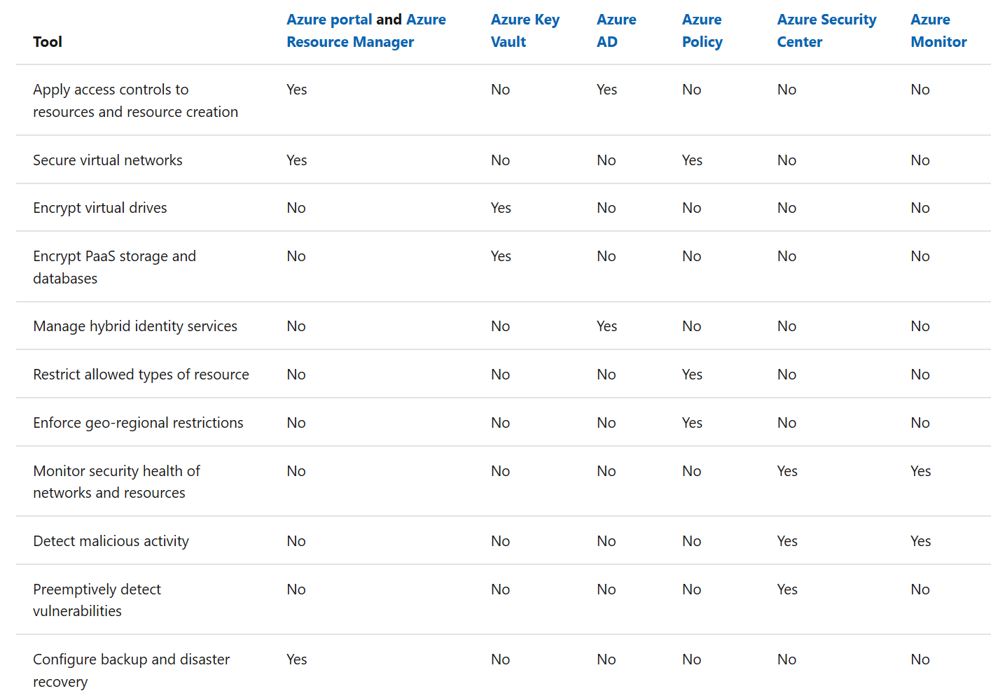
Security baseline tools in Azure
The following list of Azure tools can help mature the policies and processes that support Security Baseline.
For a complete list of Azure security tools and services, see Security services and technologies available on Azure.

Slide 83
Establish security compliance processes
The best Security Baseline tools in the cloud are only as good as the processes and policies that they support.
The following is a set of example processes commonly involved in the Security Baseline discipline which you can leverage to update security policy based on inputs from stakeholders.
Initial risk assessment and planning
Deployment planning and testing
Quarterly review and planning
Education and training
Monthly audit and reporting views
Ongoing monitoring processes
Learn more about security baseline compliance processes.

Slide 84
Exercise | Defining security baseline policies
How are you addressing asset classification?
What are the data encryption rules?
Are you isolating your networks to present data leaks?
What is the policy around external access to public data?
We need to ensure that we protect from DDoS attacks
How are you monitoring and remediating against configuration changes?
Need to ensure that there is an ongoing security review.
Notes:
Security Baseline – REF: https://docs.microsoft.com/en-us/azure/cloud-adoption-framework/govern/security-baseline/
Encryption Decision Guide – REF: https://docs.microsoft.com/en-us/azure/cloud-adoption-framework/decision-guides/encryption/
Identity Decision Guide – REF: https://docs.microsoft.com/en-us/azure/cloud-adoption-framework/decision-guides/identity/
Software Defined Networking – REF: https://docs.microsoft.com/en-us/azure/cloud-adoption-framework/decision-guides/software-defined-network/
Least-privilege access – REF: https://docs.microsoft.com/azure/active-directory/users-groups-roles/roles-delegate-by-task
Automate Security Policies – REF: https://docs.microsoft.com/en-us/azure/cloud-adoption-framework/decision-guides/policy-enforcement/
Azure Data Security & Encryption Best Practices: https://docs.microsoft.com/en-us/azure/security/azure-security-data-encryption-best-practices

Slide 85
Sample policies
All deployed assets must be categorized by criticality and data classification.
All protected data must be encrypted when at rest.
Network subnets containing protected data must be isolated from any other subnets. Network traffic between protected data subnets is to be audited regularly.
All connections between the on-premises and cloud networks must take place either through a secure encrypted VPN connection or a dedicated private WAN link.
No public facing web site backed by IaaS should be exposed to the internet without DDoS.
Governance tooling must audit and enforce network configuration requirements defined by the Security Baseline team.
Trends and potential exploits that could affect cloud deployments should be reviewed regularly by the security team to provide updates to Security Baseline tooling used in the cloud.

Slide 86
Where to go for more information
Learn more about Security Baseline Implementation
Azure tools for Security Baseline
Learn more about Microsoft Trust Center for documentation on risk assessments
Azure SQL security playbook

Slide 87
Security Baseline Discipline Activities
Operationalize Azure Security Center
Define Azure Security Center RBAC Model
Define Azure Security Center Compliance Process & RACI
Define security roles & responsibilities

Slide 88
Workshop Lab B - Govern Building a Cloud Governance MVP
Deploy the CAF Foundation landing zone blueprint to your subscription - https://docs.microsoft.com/en-us/azure/governance/blueprints/samples/caf-foundation/
Based on the Customer situation and Customer needs (next slides) prioritize and implement Security Baseline.
Notes:
Security Baseline – REF: https://docs.microsoft.com/en-us/azure/cloud-adoption-framework/govern/security-baseline/
Encryption Decision Guide – REF: https://docs.microsoft.com/en-us/azure/cloud-adoption-framework/decision-guides/encryption/
Identity Decision Guide – REF: https://docs.microsoft.com/en-us/azure/cloud-adoption-framework/decision-guides/identity/
Software Defined Networking – REF: https://docs.microsoft.com/en-us/azure/cloud-adoption-framework/decision-guides/software-defined-network/
Least-privilege access – REF: https://docs.microsoft.com/azure/active-directory/users-groups-roles/roles-delegate-by-task
Automate Security Policies – REF: https://docs.microsoft.com/en-us/azure/cloud-adoption-framework/decision-guides/policy-enforcement/
Azure Data Security & Encryption Best Practices: https://docs.microsoft.com/en-us/azure/security/azure-security-data-encryption-best-practices

Slide 89
Customer Needs—Security Baseline
Enable investigation of changes leading up to any outage
Who, when, what – including before/after state for each Azure resource
Azure resources and in-VM configuration
Ensure Windows and Linux VMs meet password complexity requirements
Enable logging across all components (identity, virtual network, virtual machine, web, and database) to support an all-encompassing monitoring solution.
Notes:
The IT security team have advised a precautionary approach to cloud adoption. The Cloud Governance team are keen to adopt a strong set of best practices to make sure the IT security and business teams feel comfortable to avoid security becoming an adoption blocker.
If a service has an outage, it is important to know the chain of events that led up to the outage and who (if anyone) caused it.
IT security require that all Azure VMs (Windows and Linux) meet their password complexity requirements. They also require that only approved OS images are used as the baseline for any VM.

Slide 90
Customer Needs—Security Baseline
Setup auditing such that software installs are monitored across Azure virtual machine resources.
When specific security events are detected (such as a port scan), allow for the execution of actions to remediate, start the investigative process or prevent further information leakage or damage
The organization's security gateways (e.g. firewalls) enforce security policies and are configured to filter traffic between domains, block unauthorized access, and are used to maintain segregation between internal wired, internal wireless, and external network segments (e.g., the Internet) including DMZs and enforce access control policies for each of the domains.
Notes:
The IT security team have advised a precautionary approach to cloud adoption. The Cloud Governance team are keen to adopt a strong set of best practices to make sure the IT security and business teams feel comfortable to avoid security becoming an adoption blocker.
If a service has an outage, it is important to know the chain of events that led up to the outage and who (if anyone) caused it.
IT security require that all Azure VMs (Windows and Linux) meet their password complexity requirements. They also require that only approved OS images are used as the baseline for any VM.

Slide 91
Customer Needs—Security Baseline Controls Backlog
Awareness of VMs in violation of the password strength policy helps you take corrective actions to ensure passwords for all VM user accounts are compliant with policy.
[Preview]: Deploy VM extension to audit Windows VM enforces password complexity requirements
[Preview]: Deploy VM extension to audit Windows VM maximum password age 70 days
[Preview]: Deploy VM extension to audit Windows VM minimum password age 1 day
[Preview]: Deploy VM extension to audit Windows VM passwords must be at least 14 characters
[Preview]: Deploy VM extension to audit Windows VM should not allow previous 24 passwords
[Preview]: Audit Windows VM enforces password complexity requirements
[Preview]: Audit Windows VM maximum password age 70 days
[Preview]: Audit Windows VM minimum password age 1 day
[Preview]: Audit Windows VM passwords must be at least 14 characters
[Preview]: Audit Windows VM should not allow previous 24 passwords
Notes:
Trey Research has deployed Office 365 and it is configured with federated access to their ADFS servers. Trey's EA has been created within the same organization.
Providing the ability to delegate permissions to different administrators at the business unit and subunit level is critical. However, for an organization the size of Trey Research, it is not possible for the Cloud Governance team to manage all user permissions centrally. Instead, for each new project, an administrator in the business unit should be able to manage access for his or her team. The business unit administrator must not be able to override or circumnavigate governance rules defined by the Cloud Governance team. Team members must be provide the access they need, to the resources they need, but no more. To maintain consistency and to enable Cloud Governance team audit, Azure access should be controlled using built-in roles only, not custom roles.
The Trey e-commerce team make significant use of contingent staff. At present, these staff are granted identities in the existing Trey directory, and are required to work on-site to gain access to Trey development and test environments. Trey would like to streamline this process and enable remote working.

Slide 92
Build the Deployment Acceleration

Slide 93
Workshop | Creating the Deployment Acceleration baseline
Estimated time frame: approx. ~ 2hrs
Participants: Cloud Architects
Outcomes:
Management groups, Subscriptions, Tags
Requirements:
Understanding of internal org structures, policies and compliance requirements
Triggers:
Getting started with Azure and need help in cloud environment setup
Need for automation and policy enforcement
Notes:
A basic slide to outline each mini-workshop…

Slide 94
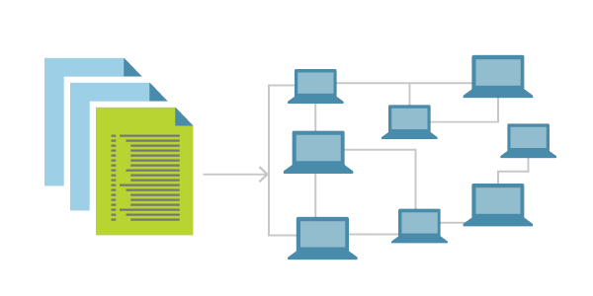
Deployment Acceleration Overview
This discipline focuses on ways of establishing policies to govern asset configuration or deployment which could be manual or fully automated through DevOps.
The DevOps practices that are leveraged in this discipline include Infrastructure as Code, Continuous Integration and Continuous Deployment.
Azure services that enable deployment acceleration include Azure Blueprints

Slide 95
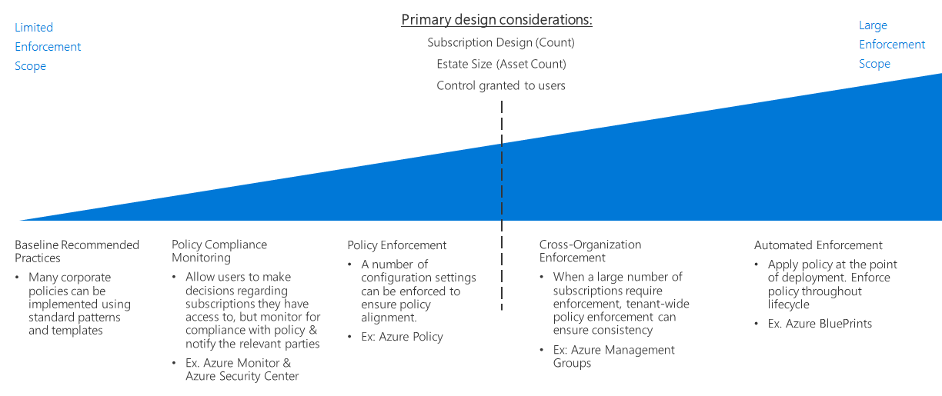
Policy enforcement decision guide
Deployment Acceleration enables automated policy enforcement
Notes:
Deployment Acceleration – REF: https://docs.microsoft.com/en-us/azure/cloud-adoption-framework/govern/deployment-acceleration/

Slide 96

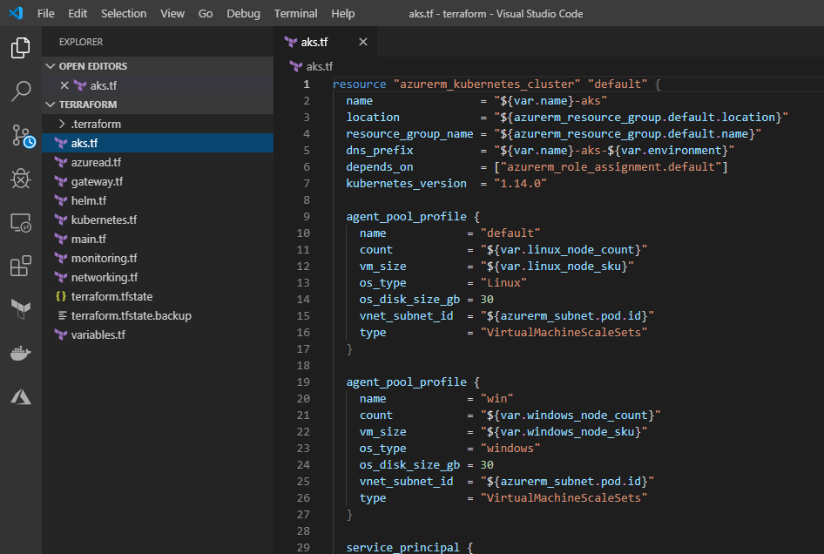

Infrastructure as code
Stand up environments in the fastest means possible.
Remove the human element and reliably and repeatable deploy every time.
Improve environment visibility and improve developer efficiency
Store your infrastructure definitions alongside your application code.
Notes:
Deployment Acceleration – REF: https://docs.microsoft.com/en-us/azure/cloud-adoption-framework/govern/deployment-acceleration/
What is infrastructure as Code? – REF: https://docs.microsoft.com/en-us/azure/devops/learn/what-is-infrastructure-as-code

Slide 97

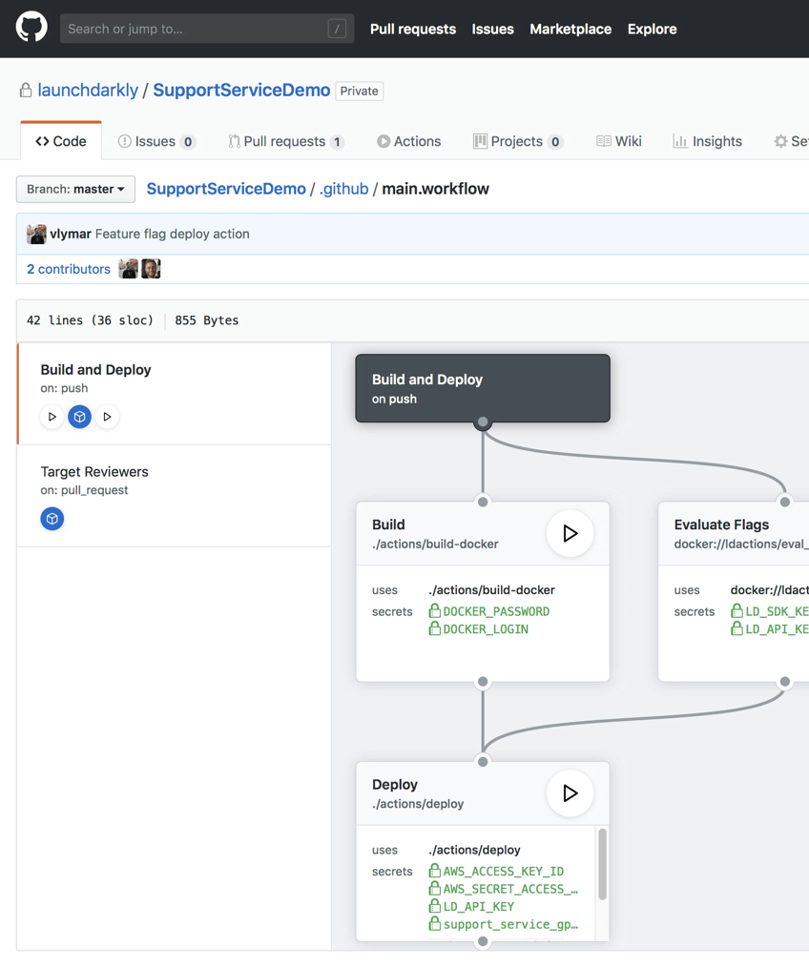
CI / CD Pipeline
Automating workflows from code to cloud
Accelerate delivery through automation
Automation triggers for 20+ project events allows for automation beyond just CI/CD to any available API
Simple and easy to use
Configuration based on YAML with a host of sample workflows to learn from and get started
Global community for actions
Thousands of open source Actions, maintained by the community and by companies offering integrations, including Microsoft Azure
Notes:
What is continuous integration – REF: https://docs.microsoft.com/en-us/azure/devops/learn/what-is-continuous-integration
What is continuous delivery – REF: https://docs.microsoft.com/en-us/azure/devops/learn/what-is-continuous-delivery

Slide 98


Azure Blueprints
Role-based access controls
deploy and update cloud environments in a repeatable manner using composable artifacts
Policy Definitions
Management groups
ARM Templates
Subscription A
Azure Blueprints
Subscription B
Resource Groups
Subscription C
…
compose
manage
scale
Notes:
Azure Blueprints – REF: https://docs.microsoft.com/en-us/azure/governance/blueprints/overview

Slide 99
Deploy the policies using Azure blueprints to create Governance MVP
Cloud Adoption Framework Foundation blueprint deploys recommended infrastructure resources to put in place the foundation controls necessary to manage the cloud estate.
This environment is composed of:
An Azure Key Vault
Deploy Log Analytics
Deploy Azure Security Center (standard version)
The blueprint also defines and deploys Azure Policies, for
Tagging (CostCenter) applied to resources groups
Append resources in resource group with the CostCenter Tag
Allowed Azure Region for Resources and Resource Groups
Allowed Storage Account SKUs (choose while deploying)
Allowed Azure VM SKUs (choose while deploying)
Require Network Watch to be deployed
Require Azure Storage Account Secure transfer Encryption
Deny resource types (choose while deploying)
Initiatives
Enable Monitoring in Azure Security Center (89 Policies)
Notes:
Key Value – REF: https://docs.microsoft.com/en-us/azure/key-vault/key-vault-overview
Azure Monitor – REF: https://docs.microsoft.com/en-us/azure/azure-monitor/overview
Security Center – REF: https://docs.microsoft.com/en-us/azure/security-center/security-center-intro
Azure Policies – REF: https://docs.microsoft.com/en-us/azure/governance/policy/overview

Slide 100
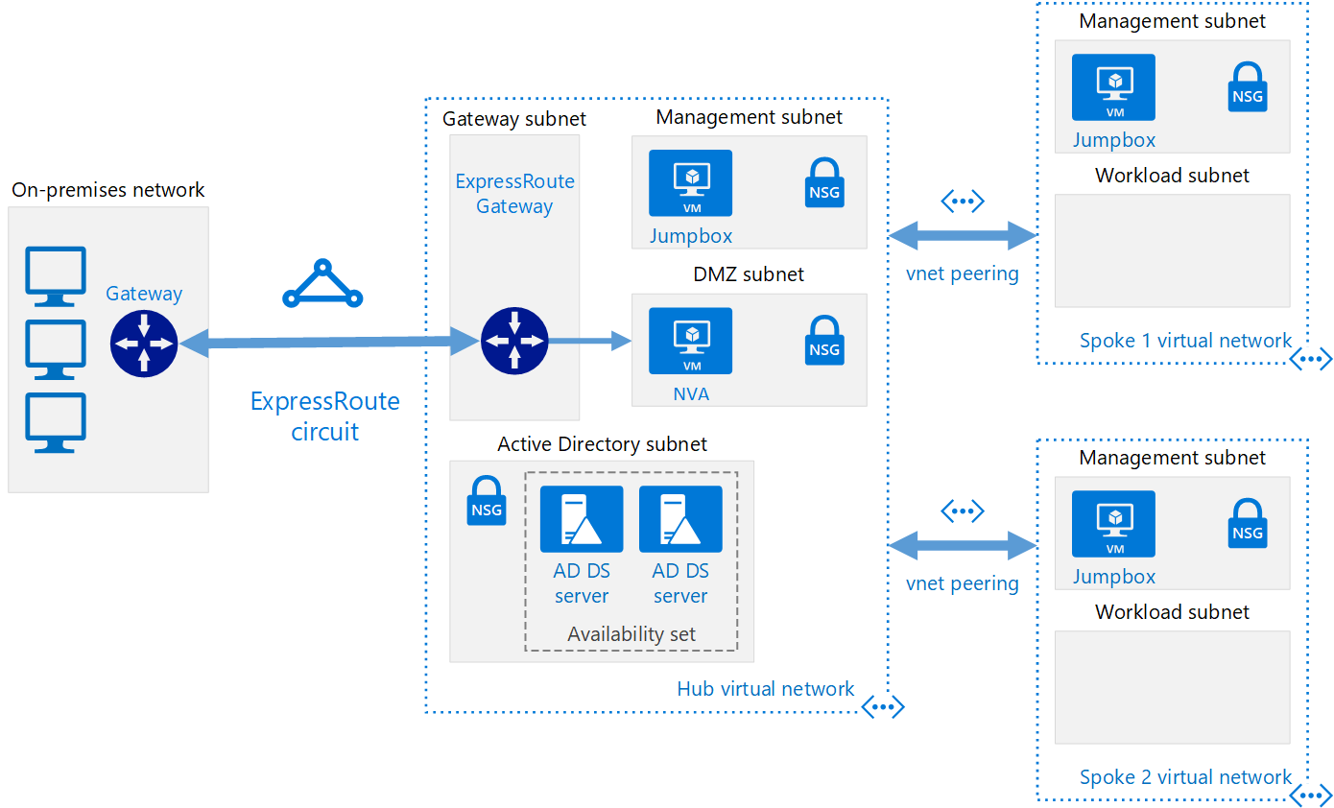
Azure Terraform landing zones - Value proposition
Aligned on Cloud Adoption Framework
Enterprise grade - Inspired by FSI requirements
Best practices in a-box
Lower entry cost to Infrastructure as Code
Community based
Easy to customize | deploy | reuse
Comes with prescriptive deployment techniques
Notes:
Azure Terraform Landing Zone Ref: https://docs.microsoft.com/en-us/azure/cloud-adoption-framework/ready/landing-zone/terraform-landing-zone

Slide 101
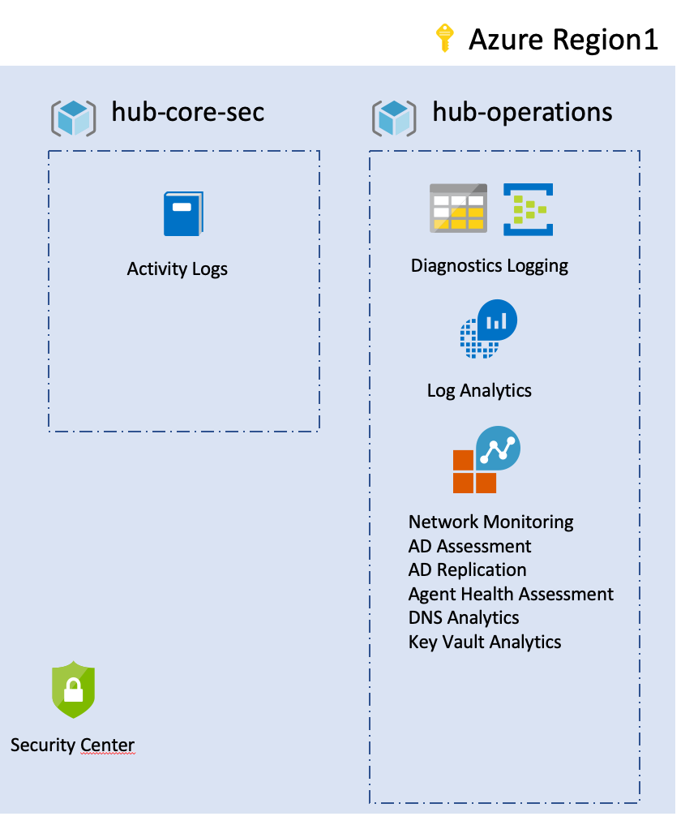
Terraform landing zone blueprint
The Cloud Adoption Framework foundational landing zone for Terraform has a set of responsibilities and features to enforce logging, accounting, and security.
This landing zone uses standard components known as Terraform modules to enforce consistency across resources deployed in the environment.
This edition can be extended by:
Adding other modules to the blueprint.
Layering additional landing zones on top of it which is a good practice for decoupling systems, versioning each component that you're using, and allowing fast innovation and stability for your infrastructure as code deployment.
Notes:
Azure Terraform Landing Zone Ref: https://docs.microsoft.com/en-us/azure/cloud-adoption-framework/ready/landing-zone/terraform-landing-zone

Slide 102
Potential activities to create deployment acceleration baseline
Introduce fully automated deployments early in the development process. This will improve the reliability of your testing processes and ensure consistency across your development, QA, and production environments.
Store all deployment artifacts such as deployment templates or configuration scripts using a source-control platform such as GitHub or Azure DevOps.
Store all secrets, passwords, certificates, and connection strings in Azure Key Vault
Evaluate the logical and physical architecture of your applications and identify opportunities to automate the deployment of application resources or improve portions of the architecture using other cloud-based resources.
Define a continuous integration and continuous deployment (CI/CD) pipeline to fully manage releasing updates to your application through your development, QA, and production environments.
Leverage infrastructure as Code technologies like ARM templates, Terraform

Slide 103
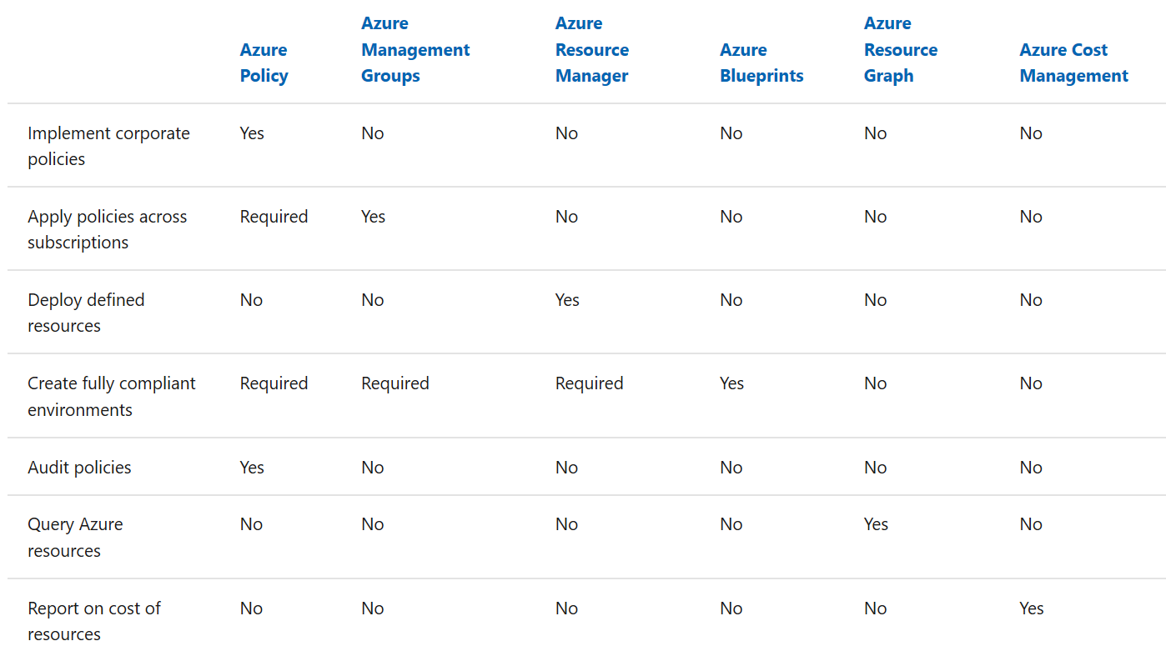
Deployment Acceleration tools in Azure
The following is a list of Azure tools that can help mature the policies and processes that support this governance discipline.

Slide 104
Workshop | Defining deployment acceleration policies
Are you using templates to deploy resources or is it a manual effort?
Do you have visibility into operational issues?
How are you managing configuration drift within your cloud environment?

Slide 105
Sample policies
All assets deployed to the cloud should be deployed using templates or automation scripts whenever possible.
Key metrics and diagnostics measures will be identified for all production systems and components.
Operations will consider using monitoring and diagnostic tools in nonproduction environments such as Staging and QA to identify system issues before they occur in the production environment.
Cloud governance processes must include monthly review with configuration management teams to identify malicious actors or usage patterns that should be prevented by cloud asset configuration.

Slide 106
Where to go for more information
Learn more about ARM Templates
Learn more about CAF aligned Azure Blueprints for landing zones
Learn about Terraform landing zones
Notes:
ARM Templates: https://docs.microsoft.com/en-us/azure/azure-resource-manager/templates/overview
CAF Aligned Azure Blueprints: https://docs.microsoft.com/en-us/azure/governance/blueprints/samples/caf-foundation/
Terraform landing zones: https://docs.microsoft.com/en-us/azure/cloud-adoption-framework/ready/expanded-scope/terraform-landing-zone

Slide 107
Deployment Acceleration Discipline Activities
Define use cases for ARM templates, Azure Blueprints, Deployment pipelines, etc.
Identify Azure solutions or workloads as candidates for acceleration
Prepare for the next phase of cloud acceleration

Slide 108
Workshop Lab B - Govern Building a Cloud Governance MVP
Deploy the CAF Foundation landing zone blueprint to your subscription - https://docs.microsoft.com/en-us/azure/governance/blueprints/samples/caf-foundation/
Based on the Customer situation and Customer needs (next slides) prioritize and implement Deployment Acceleration.

Slide 109
Customer Needs—Deployment Acceleration
Implement deployment automation while allowing controlled divergence between environments
E.g. smaller footprint for Dev/Test environments
Provide a means to track and update existing best-practice reference implementation deployments to meet updated best practices
Provide a means to prevent best-practice reference implementation deployments being modified outside the control of the Cloud Governance team
Notes:
Increased agility is one of Trey's primary motivation for adopting the cloud. They are keen to take full advantage of deployment automation to enable agile processes that will enable them to update their services more frequently and easily.
However, they are also concerned about how to maintain consistency and control across environments. They are concerned that production and test environments may diverge over time. However, they can't use identical automation in both environments, since test environments are often scaled differently to production to save costs.
The Cloud Governance team has developed best-practice reference implementations for commonly-deployed services, such as a DMZ network or a pair of web servers. They are looking for a way to automate these deployments. They recognize that these best practices will evolve over time, and so are also looking for a way to track existing deployments to ensure updates are rolled out consistently. In addition, where resources are deployed following Cloud Governance team best practices, individual business units should not be able to modify the configuration of those resources.

Slide 110
Customer Needs—Deployment Acceleration Controls Backlog
Key metrics and diagnostics measures will be identified for all production systems and components, and monitoring and diagnostic tools will be applied to these systems and monitored regularly by operations personnel.
Operations will consider using monitoring and diagnostic tools in nonproduction environments such as Staging and QA to identify system issues before they occur in the production environment.
Notes:
Increased agility is one of Trey's primary motivation for adopting the cloud. They are keen to take full advantage of deployment automation to enable agile processes that will enable them to update their services more frequently and easily.
However, they are also concerned about how to maintain consistency and control across environments. They are concerned that production and test environments may diverge over time. However, they can't use identical automation in both environments, since test environments are often scaled differently to production to save costs.
The Cloud Governance team has developed best-practice reference implementations for commonly-deployed services, such as a DMZ network or a pair of web servers. They are looking for a way to automate these deployments. They recognize that these best practices will evolve over time, and so are also looking for a way to track existing deployments to ensure updates are rolled out consistently. In addition, where resources are deployed following Cloud Governance team best practices, individual business units should not be able to modify the configuration of those resources.

Slide 111
Next Steps

Slide 112
Next Steps
Do another run of this workshop to implement all the 5 pillars of governance
After design sessions are complete, define the SoW for actual implementation

Slide 113
Appendix

Slide 114
Best practices by security area for Azure SQL
Area | Best practices
Authentication | Use Azure Active Directory (Azure AD) for centralized identity management to: Stop the proliferation of user identities across Azure SQL logical servers and databases Simplify permission management Flexible configuration Manage applications at scale Enable MFA in Azure AD using Conditional Access and use interactive authentication. Minimize the use of password-based authentication for users. Enable Azure Managed Identity. Alternatively use integrated or certificate-based authentication. Use Azure Key Vault to store passwords and secrets. Whenever applicable, use MFA for SQL DB with Azure AD users. Support legacy scenarios, tools, and applications not enabled for Azure AD authentication; Use SQL authentication
Access Management | Implement Principle of Least Privilege In Azure Portal: Use custom RBAC roles to assign just the necessary permissions In SQL Data Plane: Use granular permissions and user-defined database roles (or server-roles in MI) Implement separation of duties through permissions Identify the required level of Separation of Duties. Examples: Between development/test and production environments; Security-wise sensitive tasks vs DBA management level tasks vs Developer tasks Identify a comprehensive hierarchy of users (and automated processes) that access the system. Create roles according to the needed usergroups and assign permissions to roles. Avoid overprovisioning of permissions, unused logins and roles Perform regular checks using VA to test for too many permissions or empty roles Audit changes to Permissions and role membership as well as impersonation attempts
Learn more https://aka.ms/AzureSQLDBSecurityPlaybook

Slide 115
Best practices by security area for Azure SQL (cont.)
Area | Best practices
Data Protection | Encrypt data in transit applications and your database Encrypt data at rest Protect sensitive data in use from high privileged, unauthorized users Control access of application users to sensitive data via encryption Protect data against unauthorized viewing by application users while preserving data format
Network Security | Ensure that client machines connecting to SQL server are using Transport Layer Security. Use Azure DDoS Protection to monitor public IP addresses associated to resources deployed in virtual networks Use Advanced Threat Protection for Azure SQL Database to detect DOS attacks against databases
Monitoring, Logging and auditing | Enable SQL Database Auditing to track database events and write them to an audit log in your Azure storage account, Log Analytics workspace or Event Hubs Secure audit logs; When logging access to sensitive data, consider securing the data with data encryption.
Security Management | Ensure that the database(s) are configured to meet security best practices Enable SQL Vulnerability Assessment (VA) to scan your database for security issues, and to automatically run periodically on your databases. Identify and tag sensitive data Track access to sensitive data Visualize security and compliance status Monitor SQL-related security recommendations and active threats in Azure Security Center
Learn more https://aka.ms/AzureSQLDBSecurityPlaybook

Slide 116


Azure Customer Challenges
Designing and Building Governed Azure Subscriptions
Challenging to setup foundational infrastructure
Cumbersome to create and redeploy infra.
Takes ~7 months to setup foundational infra
Inability to create governed subscriptions
No central way to compose and enforce what goes into or made available in a subscription. Customer use a ton a scripts to try and accomplish this.
Protecting foundational resources
Subscription owners can modify resources and remove policies breaking best practices defined by Cloud Architects

Slide 117
Customer situation
Trey Research
Consumer products manufacturing (Manufacturing and Resources) company
Annual revenues of USD $29.6 billion
10,000 - 14,999 Employees
Global company
Headquarters in New Jersey
Major offices in the UK, France, and Japan
Data centers and branch offices scattered across the United States
Looking to mitigate creeping costs as well as start the transition to a modern cloud enterprise architecture
Large EA commitment to Azure
Notes:
Trey Research is a fictitious manufacturing company that builds consumer products with 29.6 billion USD in annual revenue. Trey's headquarters are in New Jersey, but they have data centers and branch offices scattered across the United States with several major offices in the United Kingdom, France, and Japan.
Even as large as it is, Trey seeks to maximize the cost-effectiveness and flexibility of its IT, especially in new projects and business units. With a dizzying number of existing business units, each with its own unique requirements from IT and ballooning costs from internal hardware and data center investment, Trey is looking to the cloud.
Trey is interested in a large-scale solution that will help mitigate creeping costs and start the transition to a modern cloud-based enterprise architecture.
Trey's technical leadership has decided to move forward with a Microsoft enterprise agreement (EA) with a heavy commitment in Microsoft Azure.

Slide 118
Customer situation - Leadership
Ken Greenwald, Trey Research’s CTO
Understands the value of the cloud
Focus on best practices and controls
Wants to avoid mistakes that lead to trouble later on
Laura Knight, Head of Cloud Governance team
Reports to Ken
Responsible for defining, implementing and enforcing Azure governance
Works with other teams to ensure best practices are adopted
Wants to adopt Microsoft's Cloud Adoption Framework as a baseline for Azure governance
Notes:
Trey Research's CTO, is aware of the potential for the cloud, but also has a keen understanding that without strong governance, Trey may end up with an environment that lacks essential business controls. These incorrect practices can then be disbursed across the enterprise, leading to an unmanageable Azure estate and costs which are hard to track or control. Ken wants to start on the right foot by enforcing common-sense best practices from the start.
Enterprise IT is responsible for managing corporate network connectivity, datacenter distribution, capacity planning, identity, and enterprise wide SaaS services for Trey Research employees. Enterprise IT is also responsible for supporting the services, datacenters, and setting auditing policy on hardware and services.
To help drive Azure adoption and best practices, Ken has chartered a Cloud Governance team within Enterprise IT, headed by Laura Knight. This team will be responsible for all aspects of Azure governance. This includes defining, implementing and enforcing cloud governance and working with other teams to ensure best practices are adopted.
Rather than re-invent the wheel, the Cloud Governance team have decided to adopt Microsoft's Cloud Adoption Framework as a baseline upon which they will build their governance implementation. This framework is divided into five disciplines.

Slide 119
Customer situation - Business strategy and focus
Short-term (Horizon 1)
Reliability, Scalability, Agility, Security - Datacenter exit Q2
Profitability - Ability to provide cost of acquisition/operations for partners
Business Value Realization - Financial justification
Medium-term (Horizon 2)
Optimize Operations - Data segmentation for business partners
Innovation - Enable developers and business units to rapidly build new services
Long-term (Horizon 3)
Enable Business Agility - Move existing assets to micro services as a means of driving greater efficiency

Slide 120
Customer situation - Business justification
Trey Research seeks to create a financial model to showcase the long-term cash savings of the migration. In addition, provide deeper analytics for the fully burdened cost by partner enabling the ability to increase profitability. Microsoft can partner with Trey Research financial teams to build out a financial modelling to support the onboarding of new partners.

Slide 121
Customer situation - Organizational alignment
Cloud Strategy Team
Finance
Line of business
Human resources
Operations
Enterprise architecture
IT infrastructure
Application groups
Project managers (Often with Agile project management experience)
Cloud Governance Team
IT governance
Enterprise architecture
Security
IT operations
IT infrastructure
Networking
Identity
Virtualization
Business continuity and disaster recovery
Application owners within IT
Finance owners
Notes:
It is essential that as we adopt cloud we think about the individuals and roles that they will play in the future service delivery model. As iterated before “Cloud is a model, not just a place”. This will mean that we need to thing about how we leverage teams to be more agile and respond to ever changing demands. We need to ensure that the teams can help drive alignment and accountability.
There are many ways that we can align the organization, the recommendations below are based on what we see with other customers and will start with the principle of a minimal viable product (MVP) and then evolve as Contoso progresses with the adoption.
Our guidance is to start with 2 teams, a Cloud Strategy Team and a Cloud Governance Team
The Cloud Strategy Team is responsible for leading the cloud adoption within your organization, supporting all business outcomes, people and processes changes and technical projects identified within this plan. The types of roles typically found in the strategy team are:
Finance
Line of business
Human resources
Operations
Enterprise architecture
IT infrastructure
Application groups
Project managers (Often with Agile project management experience)
The Cloud Governance Team ensures that risks and risk tolerance are properly evaluated and managed. This capability ensures the proper identification of risks that can't be tolerated by the business have the correct governing corporate policies. Here are some of the roles which we believe form part of your Governance team:
IT governance
Enterprise architecture
Security
IT operations
IT infrastructure
Networking
Identity
Virtualization
Business continuity and disaster recovery
Application owners within IT
Finance owners

Slide 122
IT organization
Each business unit has its own IT resources and IT budget
Track and alert on costs by business unit, project, and workload type
Delegate management to business unit IT
Trey Research
Industrial & Consumer
Electronics
Life Sciences
Product
Development
Marketing
Sales & Support
Product
Development
Marketing
Sales & Support
Product
Development
Marketing
Sales & Support
Regional (US/EU/Asia)
Regional (US/EU/Asia)
Regional (US/EU/Asia)
Notes:
Trey Research has three business units: Industrial and Consumer, Electronics, and Life Sciences. Each of the Business Units has the same subunits: Product development, Marketing, and Sales and Support. Sales and Support is further divided into region subunits (US/EU/Asia).

Slide 123
Customer situation
Sprawling IT estate, including a substantial legacy server footprint
Windows servers including both x32 and x64 hardware running Windows Server 2003 through to 2016
Linux servers running a mix of RHEL 6.10 and 7 series (7.2 through 7.6) and Ubuntu 16.04
The above servers comprise both physical machines as well as VMs hosted on VMware infrastructure managed by vCenter 6.5
Multiple database engines, including Microsoft SQL Server, PostGreSQL, and Cassandra
448 servers identified
No clear view of entire estate
Notes:
The CTO Ken Greenwald, was hired 6 months ago from outside the company, with a mandate to address ever-increasing IT costs. He has identified a sprawling IT estate, including a substantial legacy server footprint. New servers and services have been accumulated over time, without consolidating existing infrastructure. This includes:
- Windows servers including both x32 and x64 hardware running Windows Server 2003 through to 2016
- Linux servers running a mix of RHEL 6.10 and 7 series (7.2 through 7.6) and Ubuntu 16.04
- The above servers comprise both physical machines as well as VMs hosted on VMware infrastructure managed by vCenter 6.5
- Multiple database engines, including Microsoft SQL Server, PostgreSQL, and Cassandra
In total, 448 servers and VMs have been identified to date, distributed across 5 main locations, all in the US. There is a complex web of dependencies between servers and no-one has a clear view of the entire estate. Fear of breaking an existing system has been one of the drivers of server count and sprawl.

Slide 124
Customer objections
Per-subscription configuration won't scale to an organization the size of Trey Research. How can governance controls be implemented with minimum per-subscription configuration overhead?
As well as implementing our governance rules on how Azure is used, we need a way to audit that no deployments have been made that bypass those rules. This audit needs to scale across the entire organization.

Slide 125
Customer objections
How can we ensure our deployments meet Azure security best practices, and how can we protect our Production workloads even if the security perimeter is compromised?
How can Azure help control the costs associated with non-Production VMs left running out-of-hours?

